Slide 1
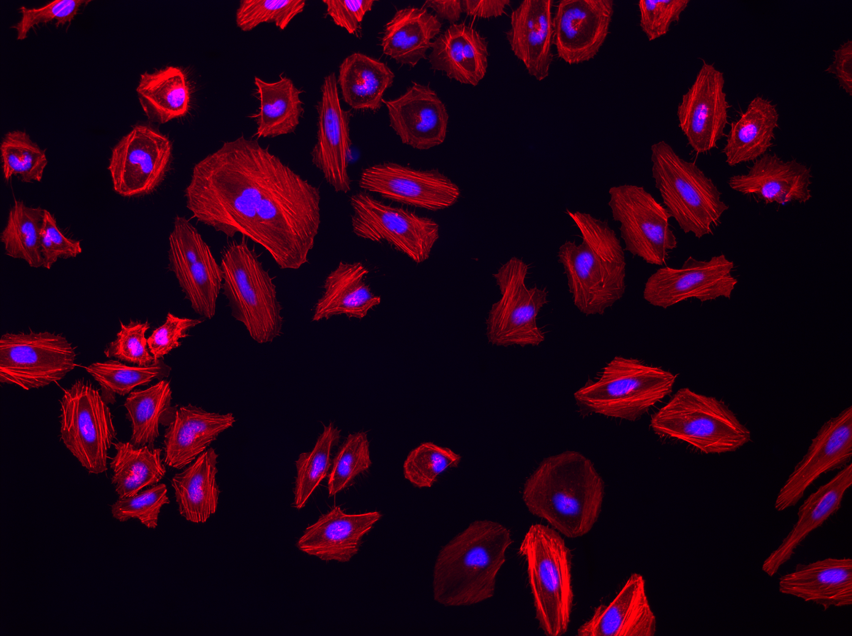
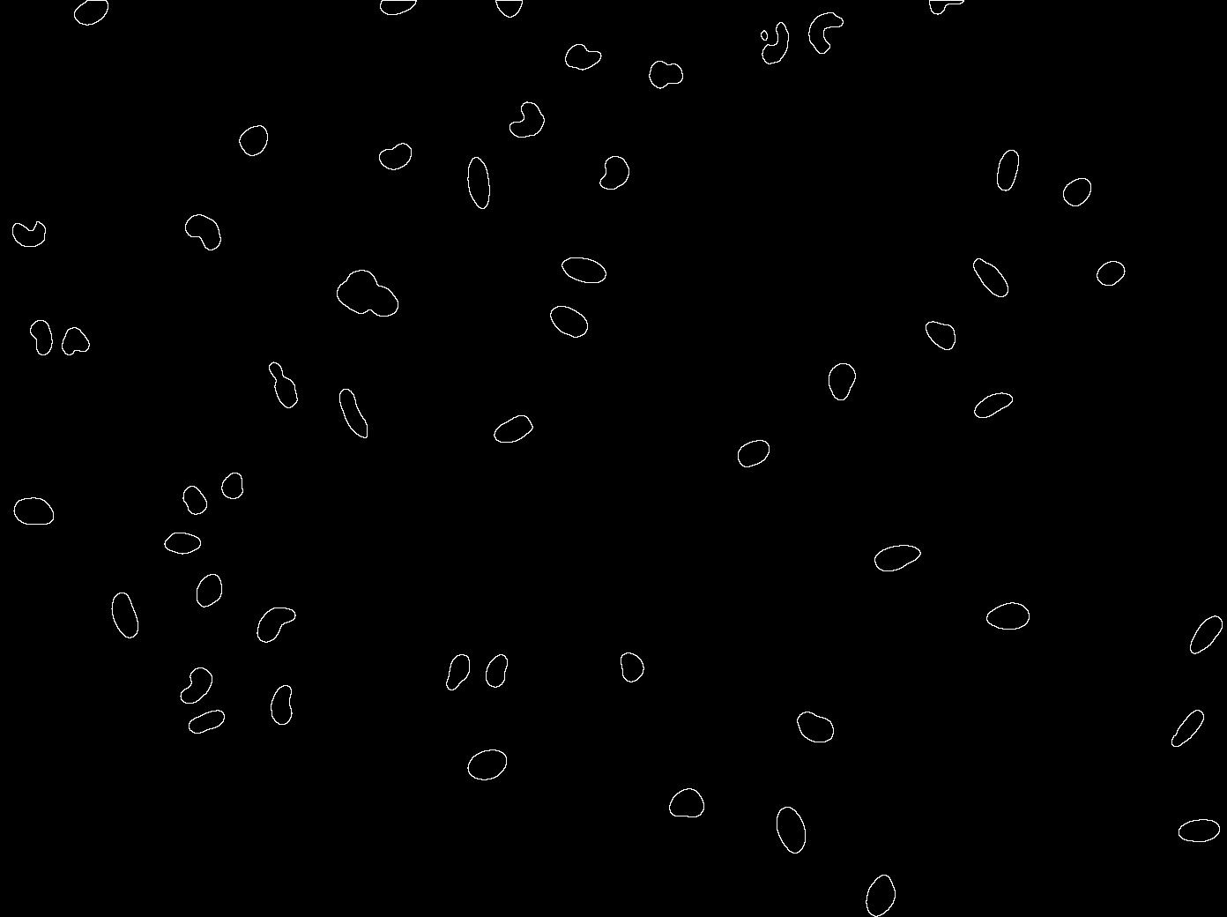


Introduction to Image Analysis

Slide 2
Please help yourselves to tea and coffee!

Slide 3
Attendance is being logged.
Please email me (david.barry@crick.ac.uk) to let me know you’re here!

Slide 4
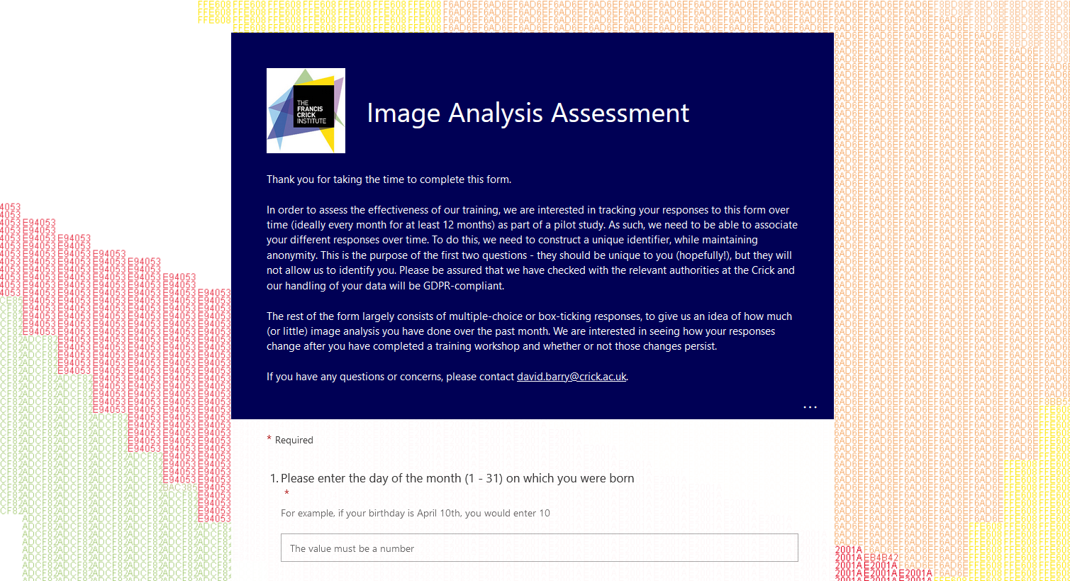
Please complete the assessment form!

Slide 5
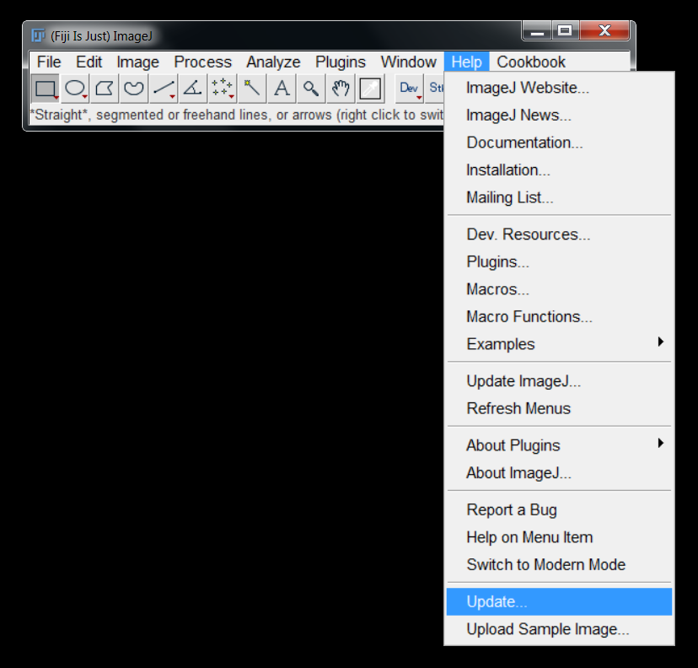
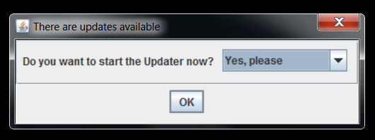
Please ensure Fiji is installed correctly!
Run the updater!

Slide 6
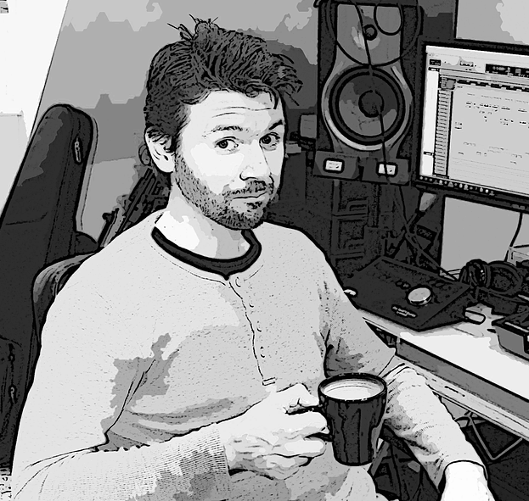
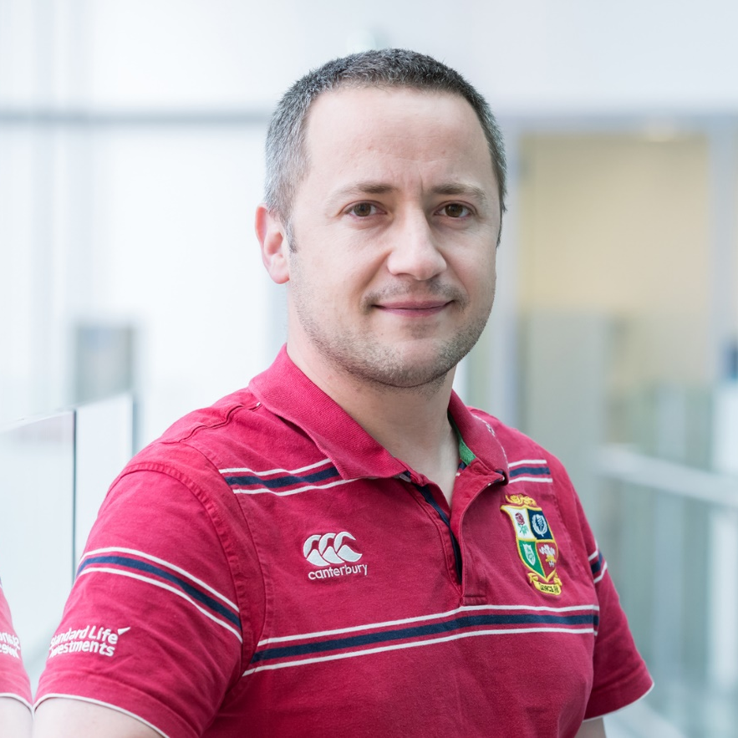
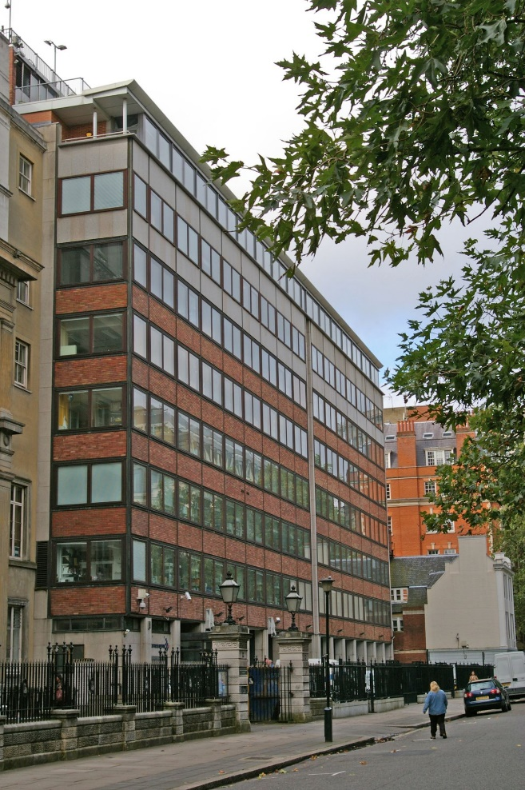

Dave Barry
CALM STP
Martin Jones
EM STP

Slide 7
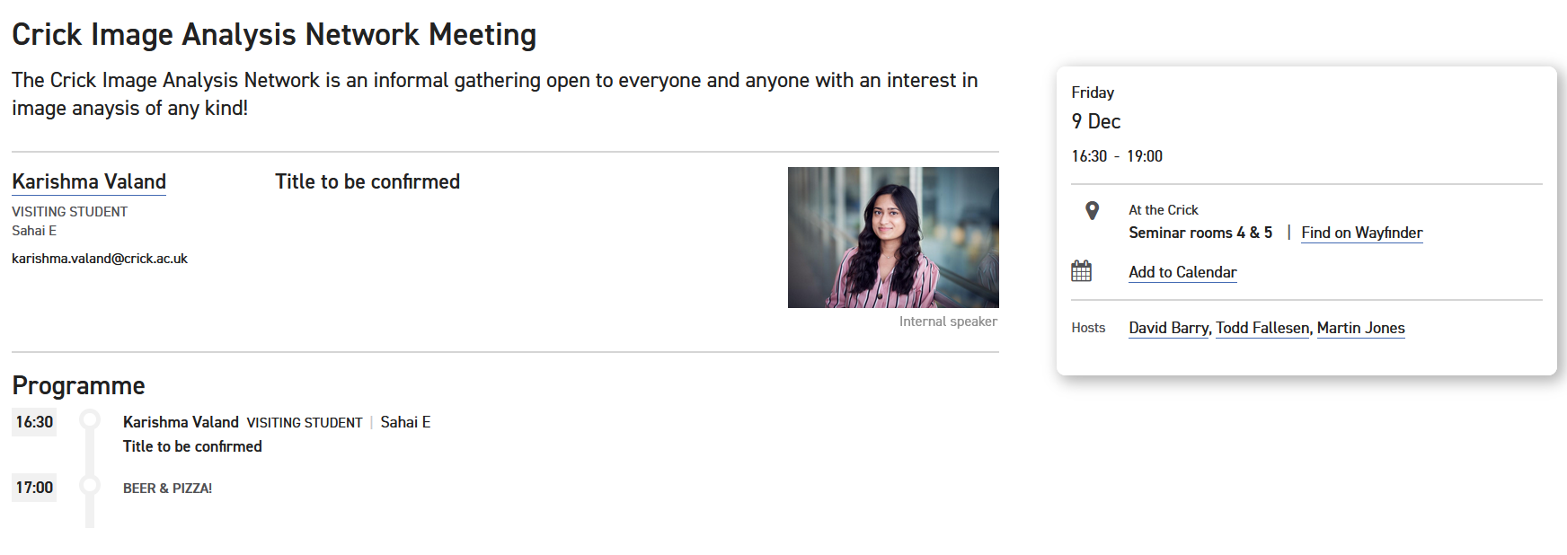

Slide 8

21 – 22 November 2022

Slide 10
Are you interested in learning about any of the following topics?
1 | Quantifying fluorescence intensity
2 | Counting objects
3 | Filtering images
4 | Segmentation
5 | Scripting
6 | Colocalisation
7 | Analysing large, multi-dimensional data

Slide 11
Are you interested in learning about any of the following topics?
1 | Quantifying fluorescence intensity
2 | Counting objects
3 | Filtering images
4 | Segmentation
5 | Scripting
6 | Colocalisation
7 | Analysing large, multi-dimensional data

Slide 12
Are you interested in learning about any of the following topics?
1 | Quantifying fluorescence intensity
2 | Counting objects
3 | Filtering images
4 | Segmentation
5 | Scripting
6 | Colocalisation
7 | Analysing large, multi-dimensional data

Slide 13
Are you interested in learning about any of the following topics?
1 | Quantifying fluorescence intensity
2 | Counting objects
3 | Filtering images
4 | Segmentation
5 | Scripting
6 | Colocalisation
7 | Analysing large, multi-dimensional data

Slide 14

What do we hope to achieve?
How to open (virtually) any image data:
LIF, ND2, CZI, etc.
Interpreting pixel values and image histograms:
Understanding bit depth, look-up tables, assessing over/under-exposure
Basic segmentation
Detecting objects such as cells, nuclei, etc.
Filtering images
Suppress noise, obtain “cleaner” segmentation
Introduction to morphological quantification
Counting cells, quantifying area, etc.
Analysis of protein expression
Is a protein localised to a particular sub-cellular region
You should understand how to automatically detect a cell and quantify the fluorescence within it

Slide 15

Aims
Introduction to image analysis concepts
Gentle introduction to FIJI
Schedule
Morning
10:00 Introduction
10:30 Opening Images, Display Contrast
11:00 Bit Depth, Look-Up Tables, Histograms
11:30 Coffee Break
11:45 Filtering, Segmentation & Quantification
13:00 Lunch
Afternoon
14:00 Challenge 1
15:15 Quantifying Protein Expression
15:30 Coffee Break
15:45 Challenge 2
16:30 Further Challenges (Time Permitting)
17:00 Any Questions?
17:30 Wrap Up

Slide 16
You don’t need to take notes – I will send you the slides after the workshop

Slide 17
?
?
?
PLEASE ASK QUESTIONS!!!!
?
?
?

Slide 18
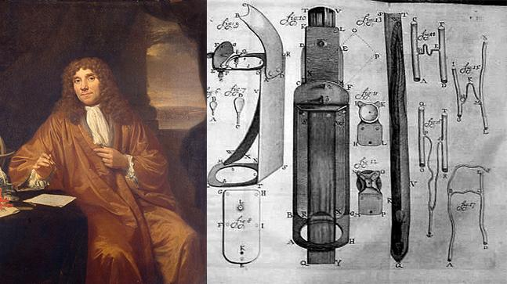
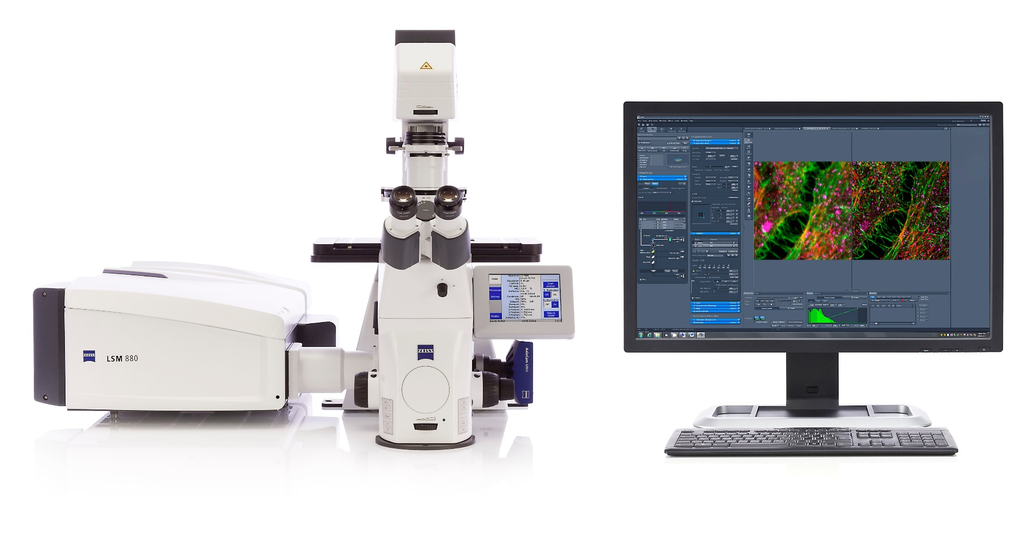
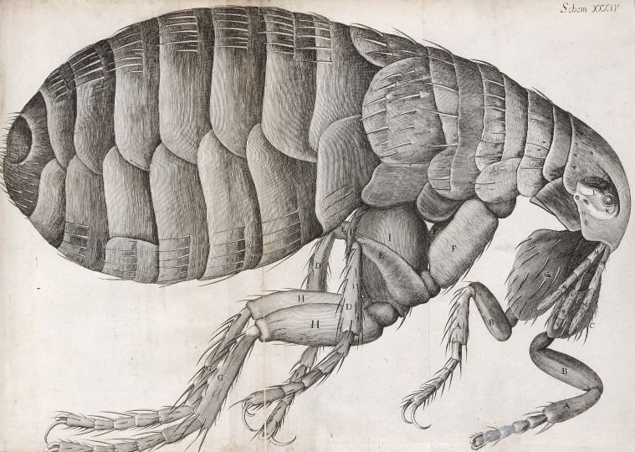
Why Use Quantitative Image Analysis?

Slide 19
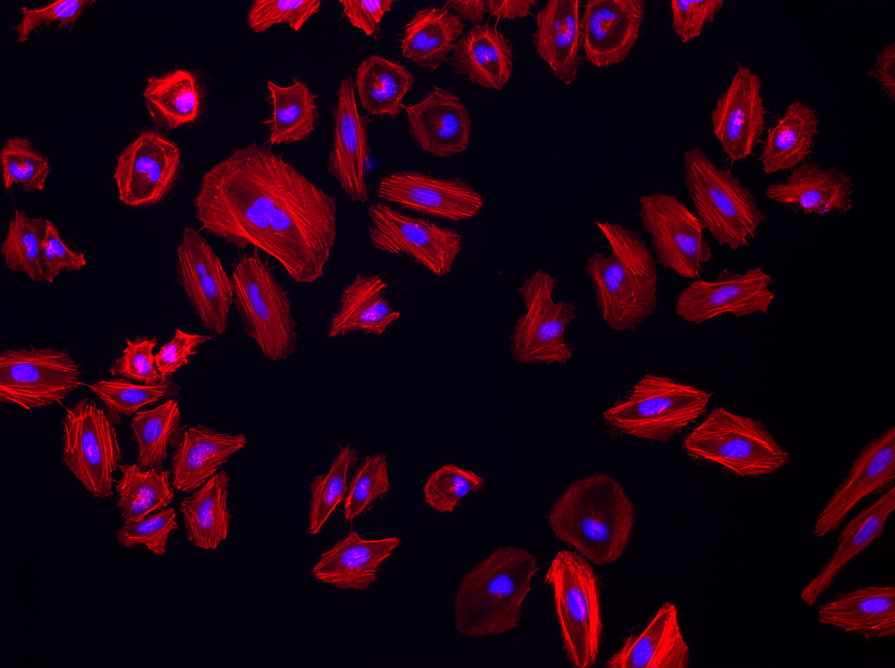
Experimental Outputs
Quantitative Data
Experimental Design
Modeling
Lots of Images
“Representative Image”

Slide 20
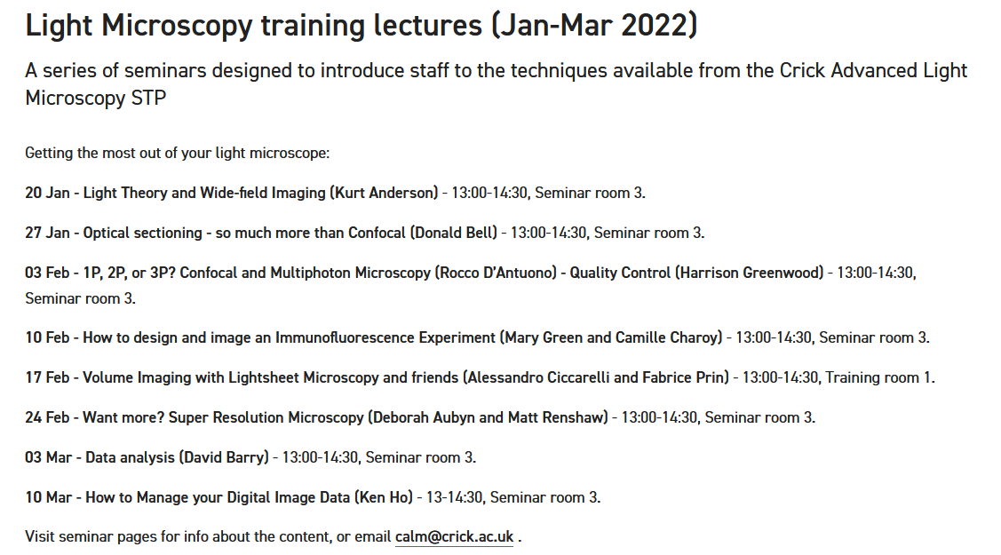
Experimental Planning
Image Acquisition
Image Pre-Processing
Image Analysis
Data Analysis & Interpretation

Slide 21

Super Good Image Analysis Pipeline
CRAP
CRAP

Slide 22
Fixed coverslips
Live cell single well
Live cell multi-well
CAMP predicted to be full by May 2020

Slide 23
Image Acquisition
Image Pre-Processing
Segmentation
Background Subtraction
Noise Suppression
Separate Objects from Background
Creation of Binary or Mask Image
Analysis
Counting & Quantification
Fluorescence Analysis
Spatial Resolution
Frame Rate
Exposure Time
Fluorophores
Imaging Modality
Create Different Regions of Interest
Track Over Time
Processing
Analysis

Slide 24



Analysis v Processing ?
Processing:
Processing should be kept to a minimum – reduces information content in image
Analysis:
DATA

Slide 25
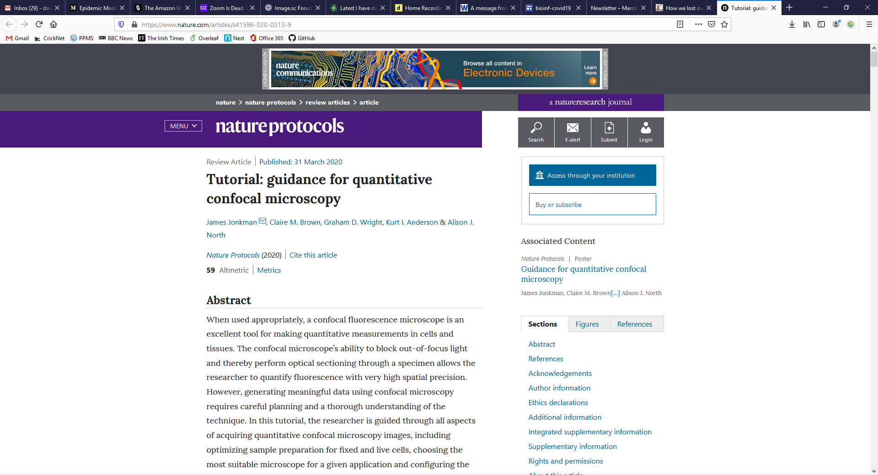
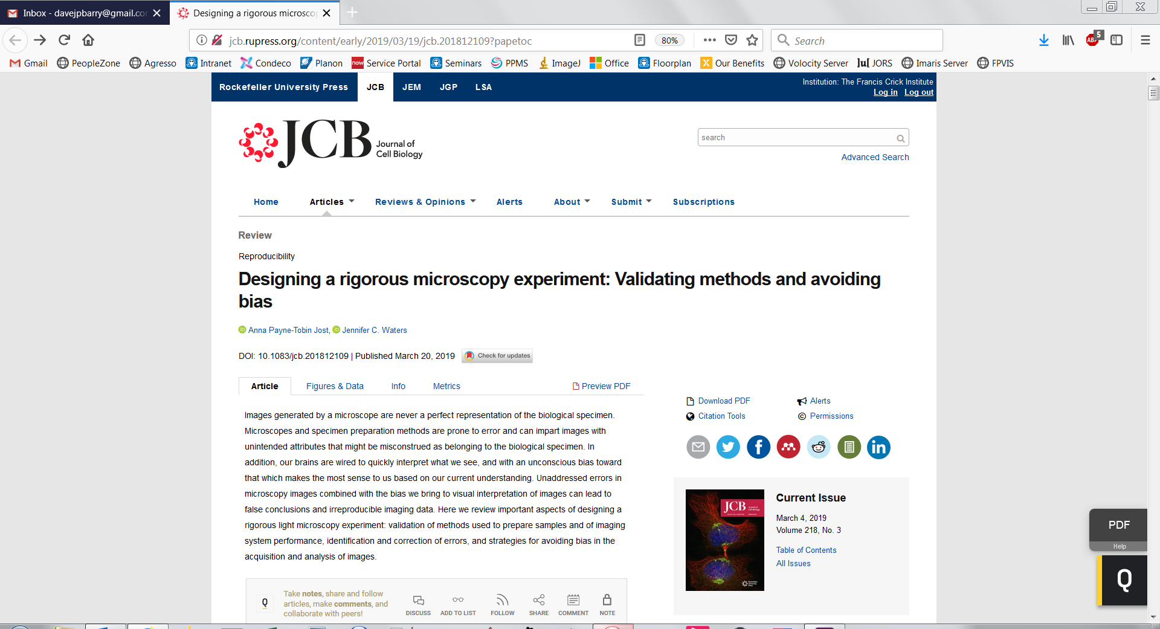

Slide 26
There are several different ways to arrive at a solution
There is rarely one single correct solution

Slide 27
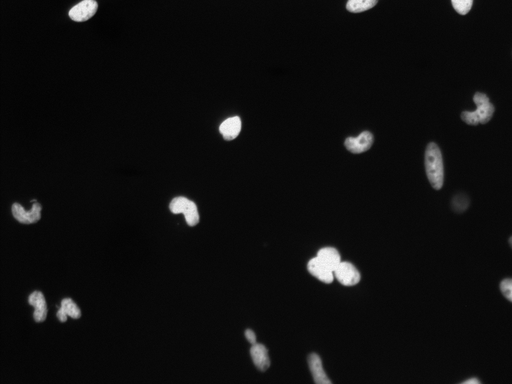
First Quiz: How many nuclei are there?
Notes:
5 minutes, 0 points

Slide 28

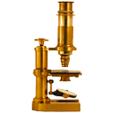
FIJI:
Fiji Is Just ImageJ
Actively maintained, with frequent updates.
ImageJ:
Open source
Public domain, cross-platform.
Read most image formats (via bioformats).
Same standard functions as proprietary packages.
Open architecture.

Slide 29
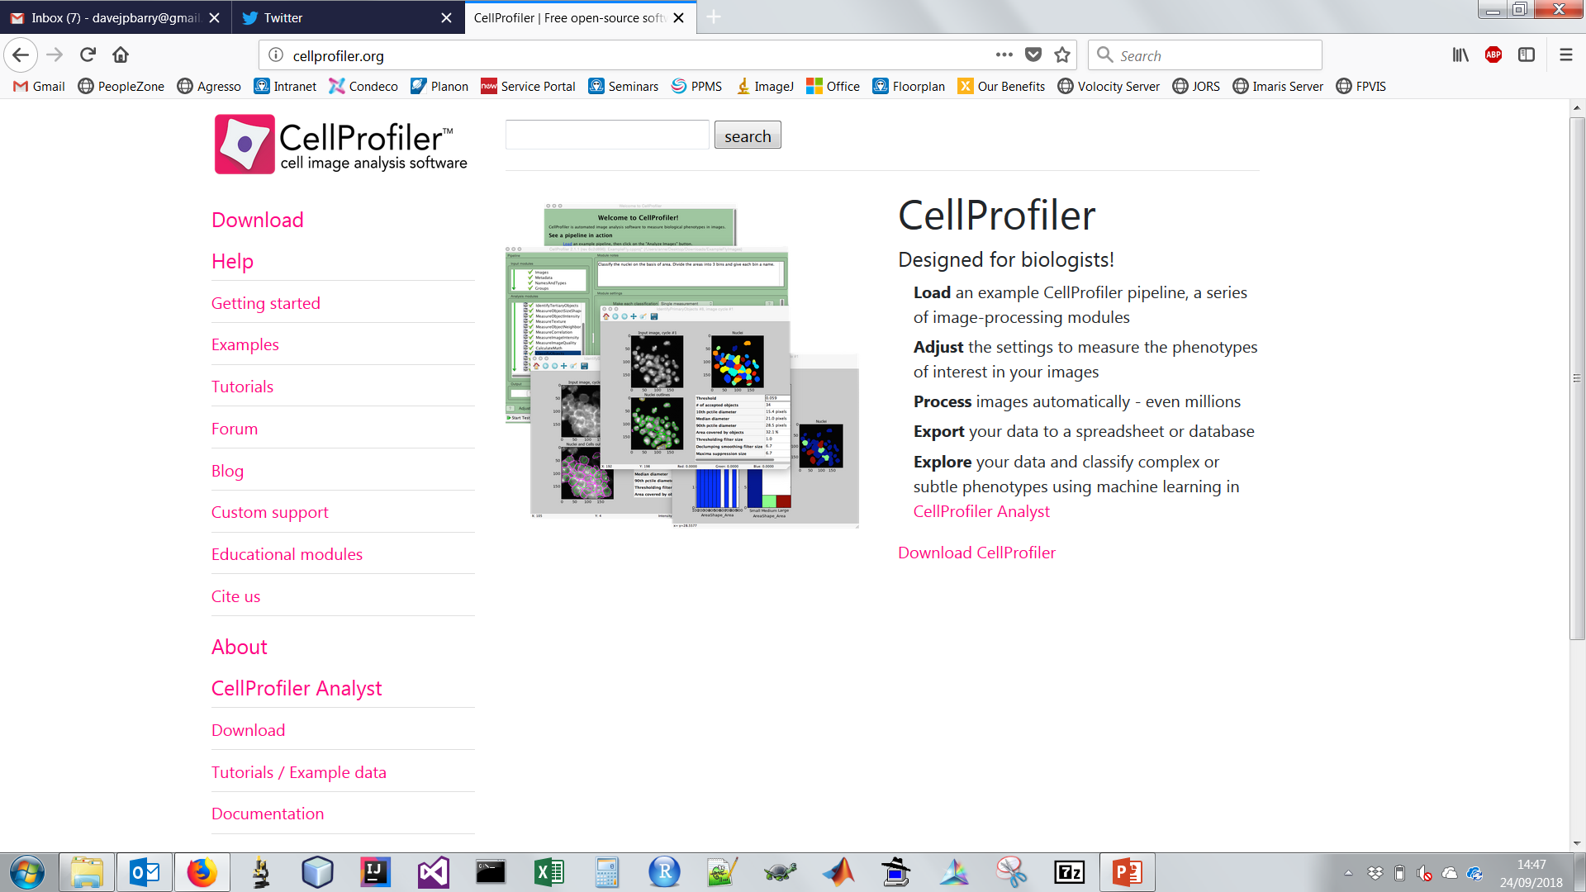
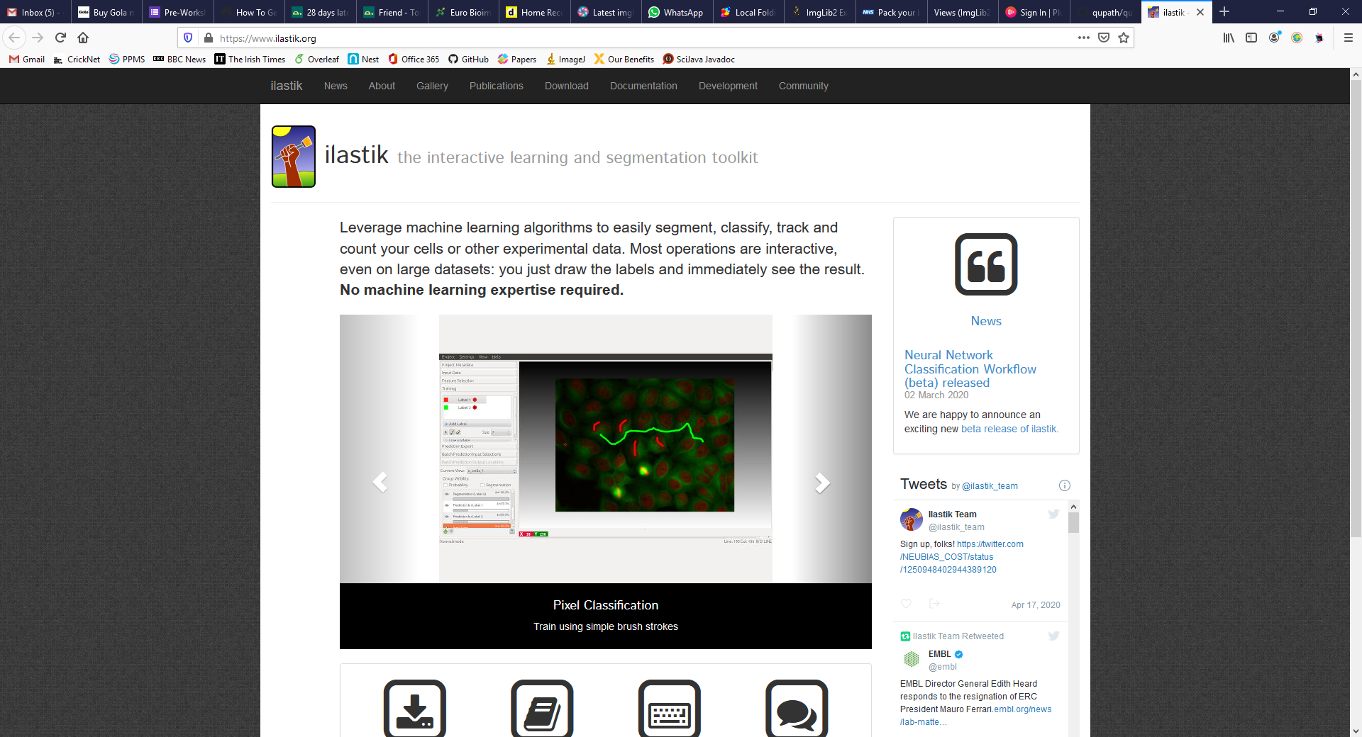
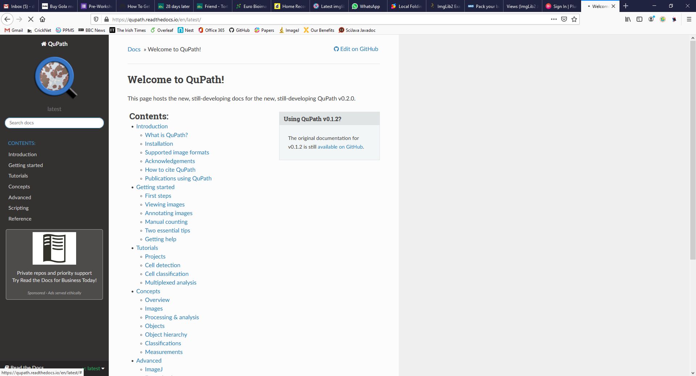

Slide 30
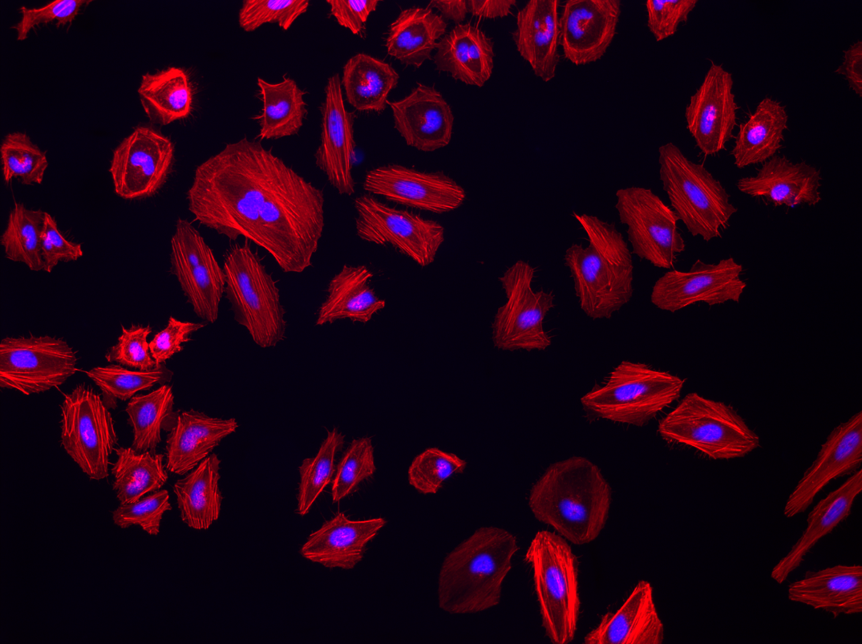
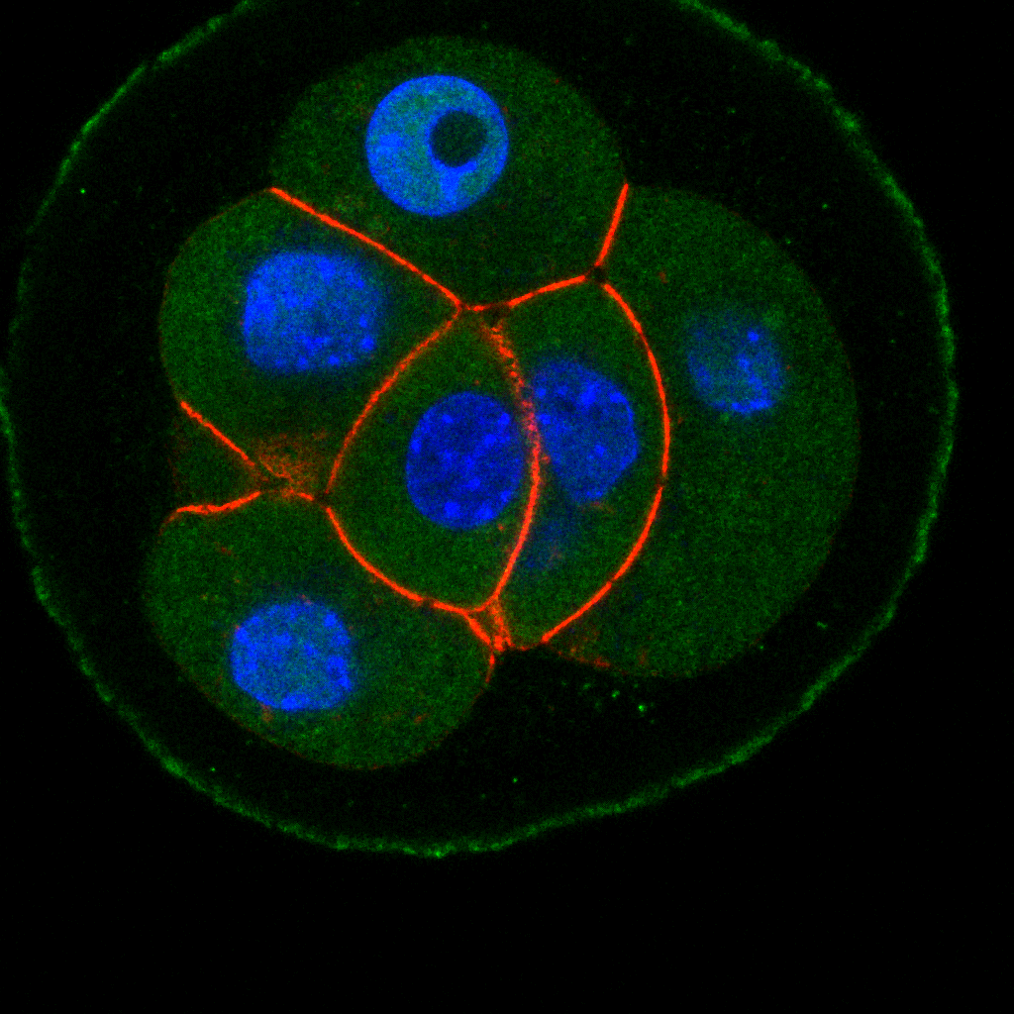
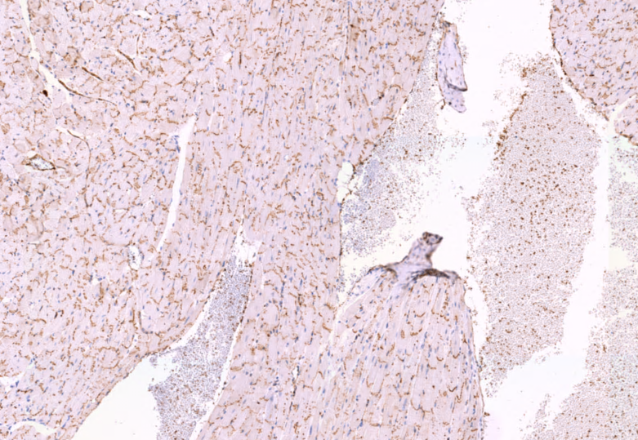
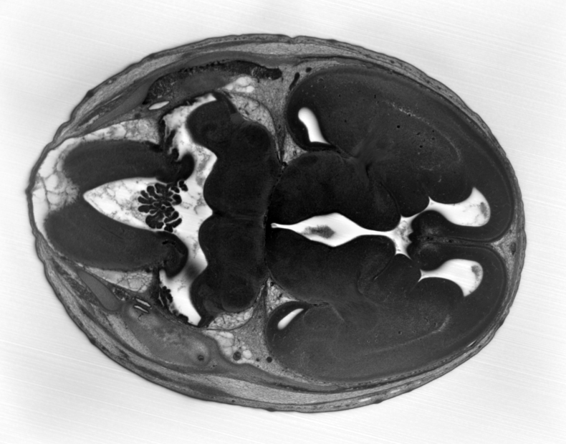

Slide 31
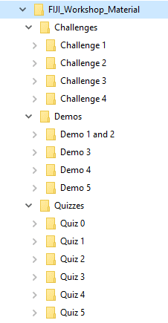
4 Teams
5 Quizzes - 40 Points in Total:
8 points for each correct answer
4 Challenges - 60 Points in Total:
10-40 points for each successfully completed
Points awarded depends on time taken
Team with highest score in June 2023 wins a prize

Slide 32
Let us begin…

Slide 33
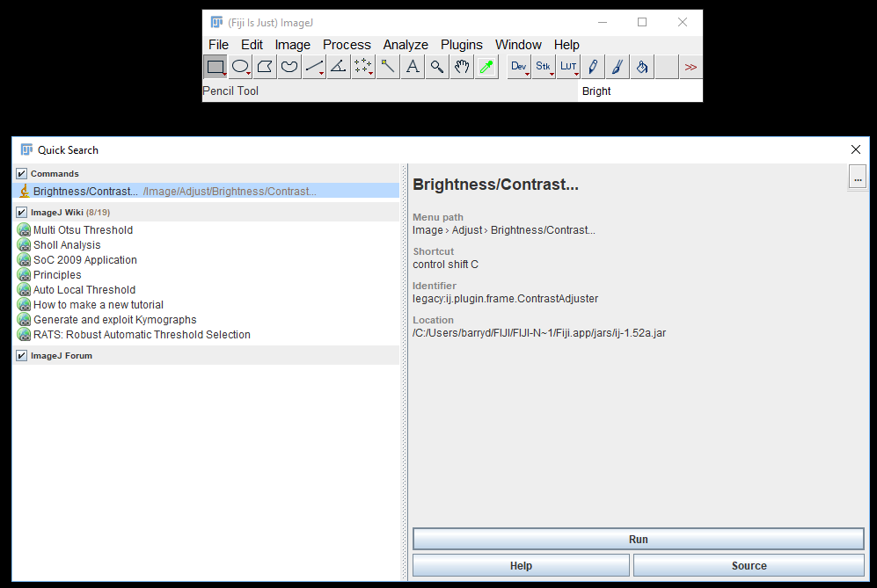
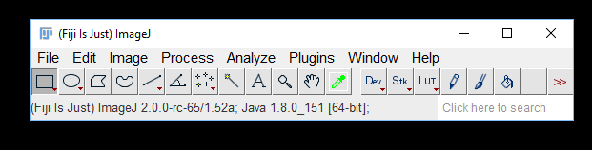
If you forget how to access something…

Slide 34
Updating FIJI

Slide 35
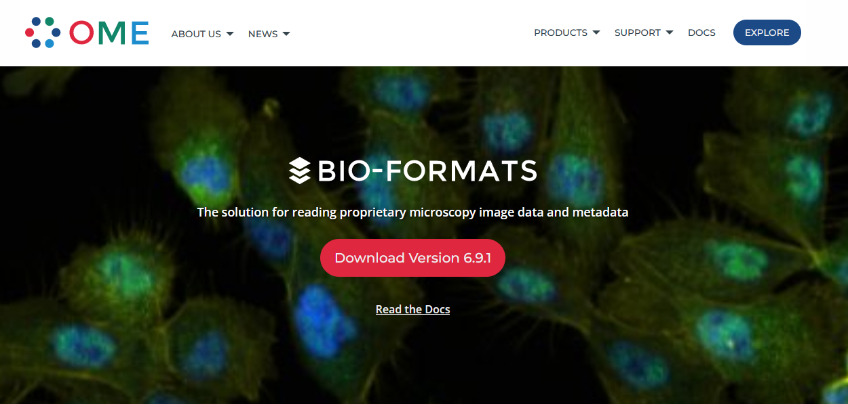
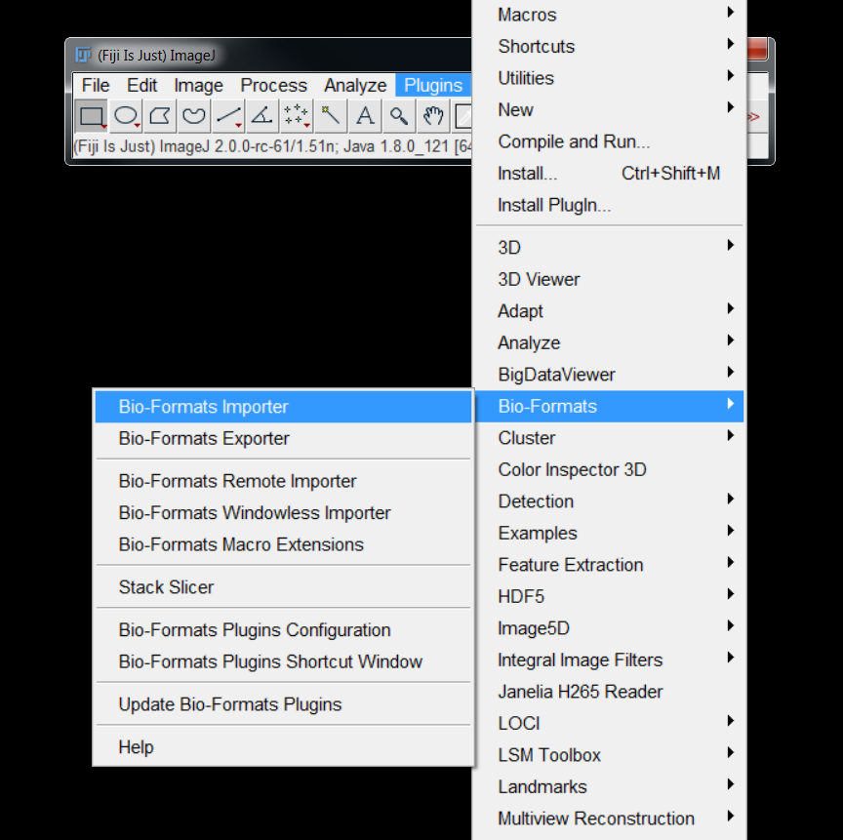
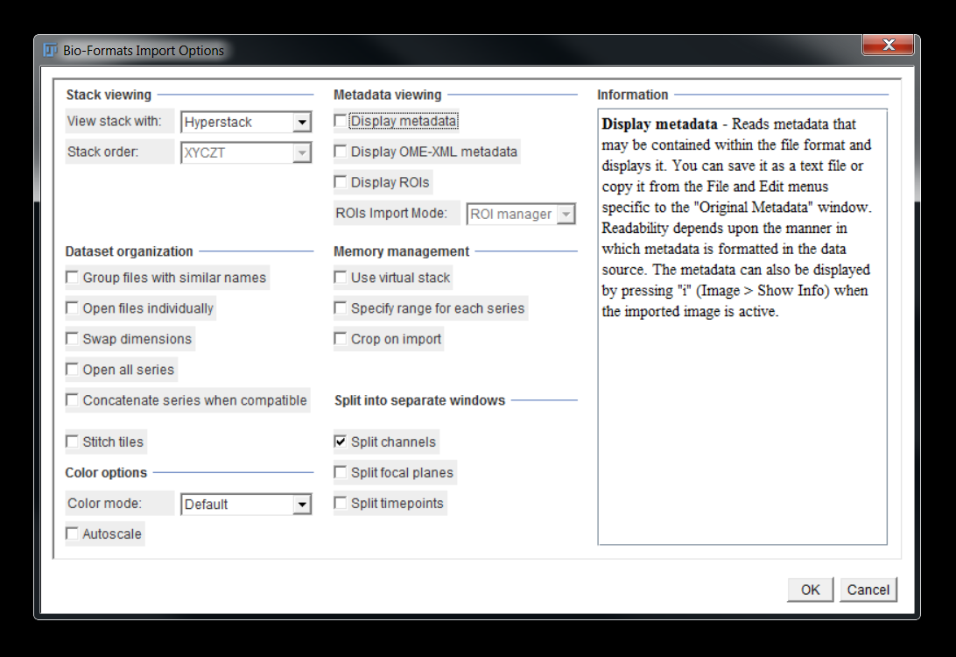
Opening an Image
Don’t Drag & Drop

Slide 36
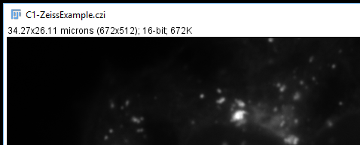
Bit Depth
Calibrated Dimensions
Image Size in Pixels
Image Size in RAM

Slide 37
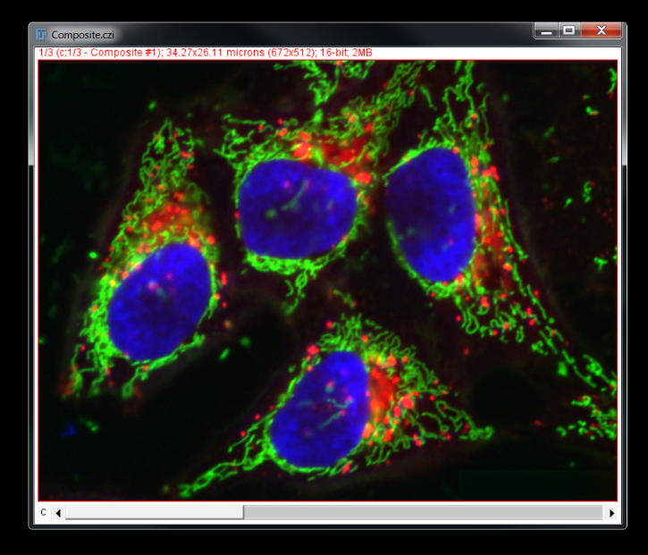
Demo 1 – Opening Images with Bioformats
Import Zeiss (CZI) Dataset:
Overview of various options presented in Bioformats GUI
Illustration of reading of MetaData

Slide 38
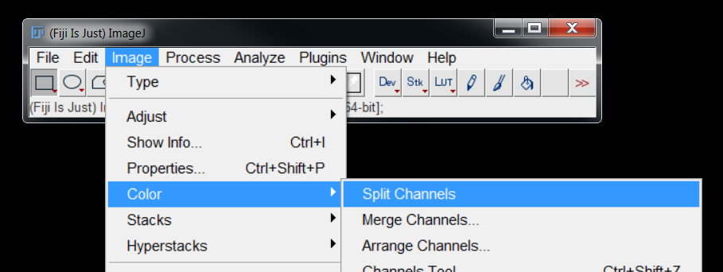
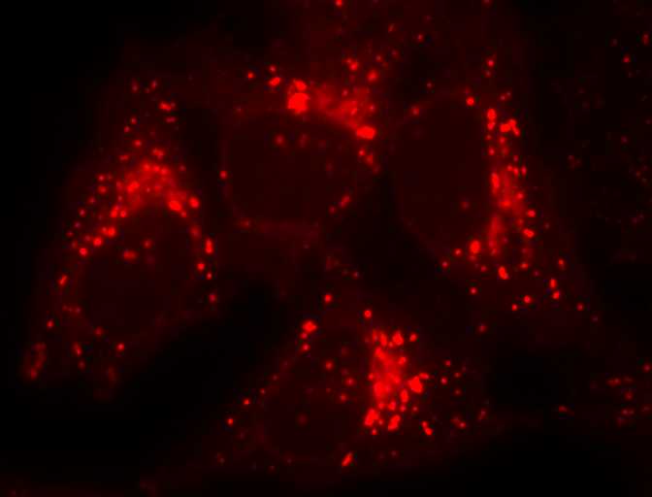
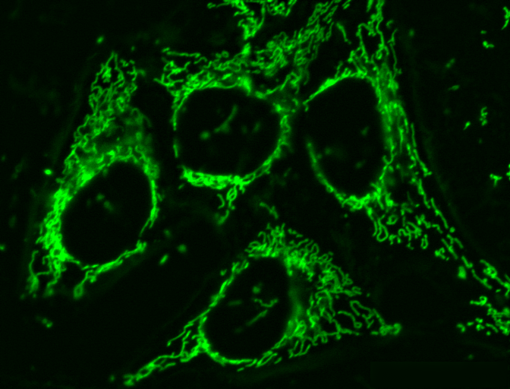
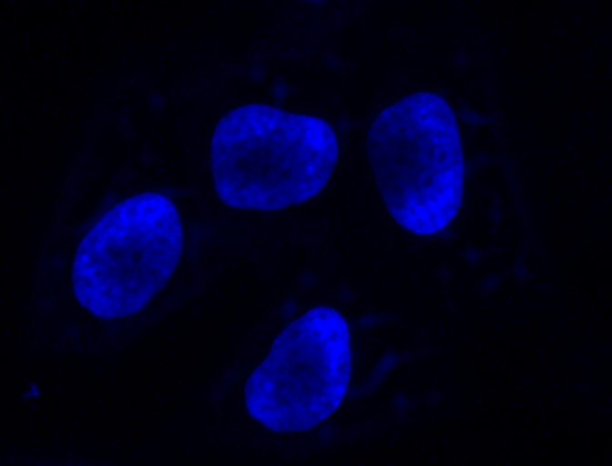
Splitting Channels

Slide 39
Quiz 1 – Opening Images with Bioformats
Open the image in the Quiz 1 folder
8 Points:
Submit the correct spatial resolution (pixel size) via the online form
Notes:
1 point, 4 minutes

Slide 40




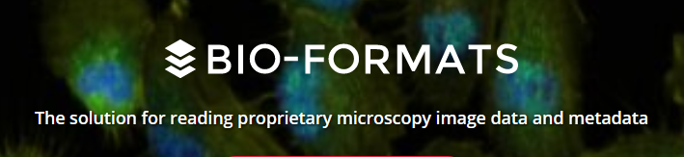

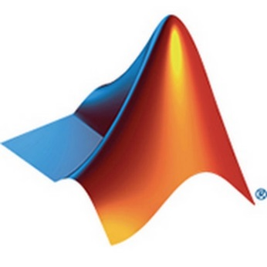


Slide 41
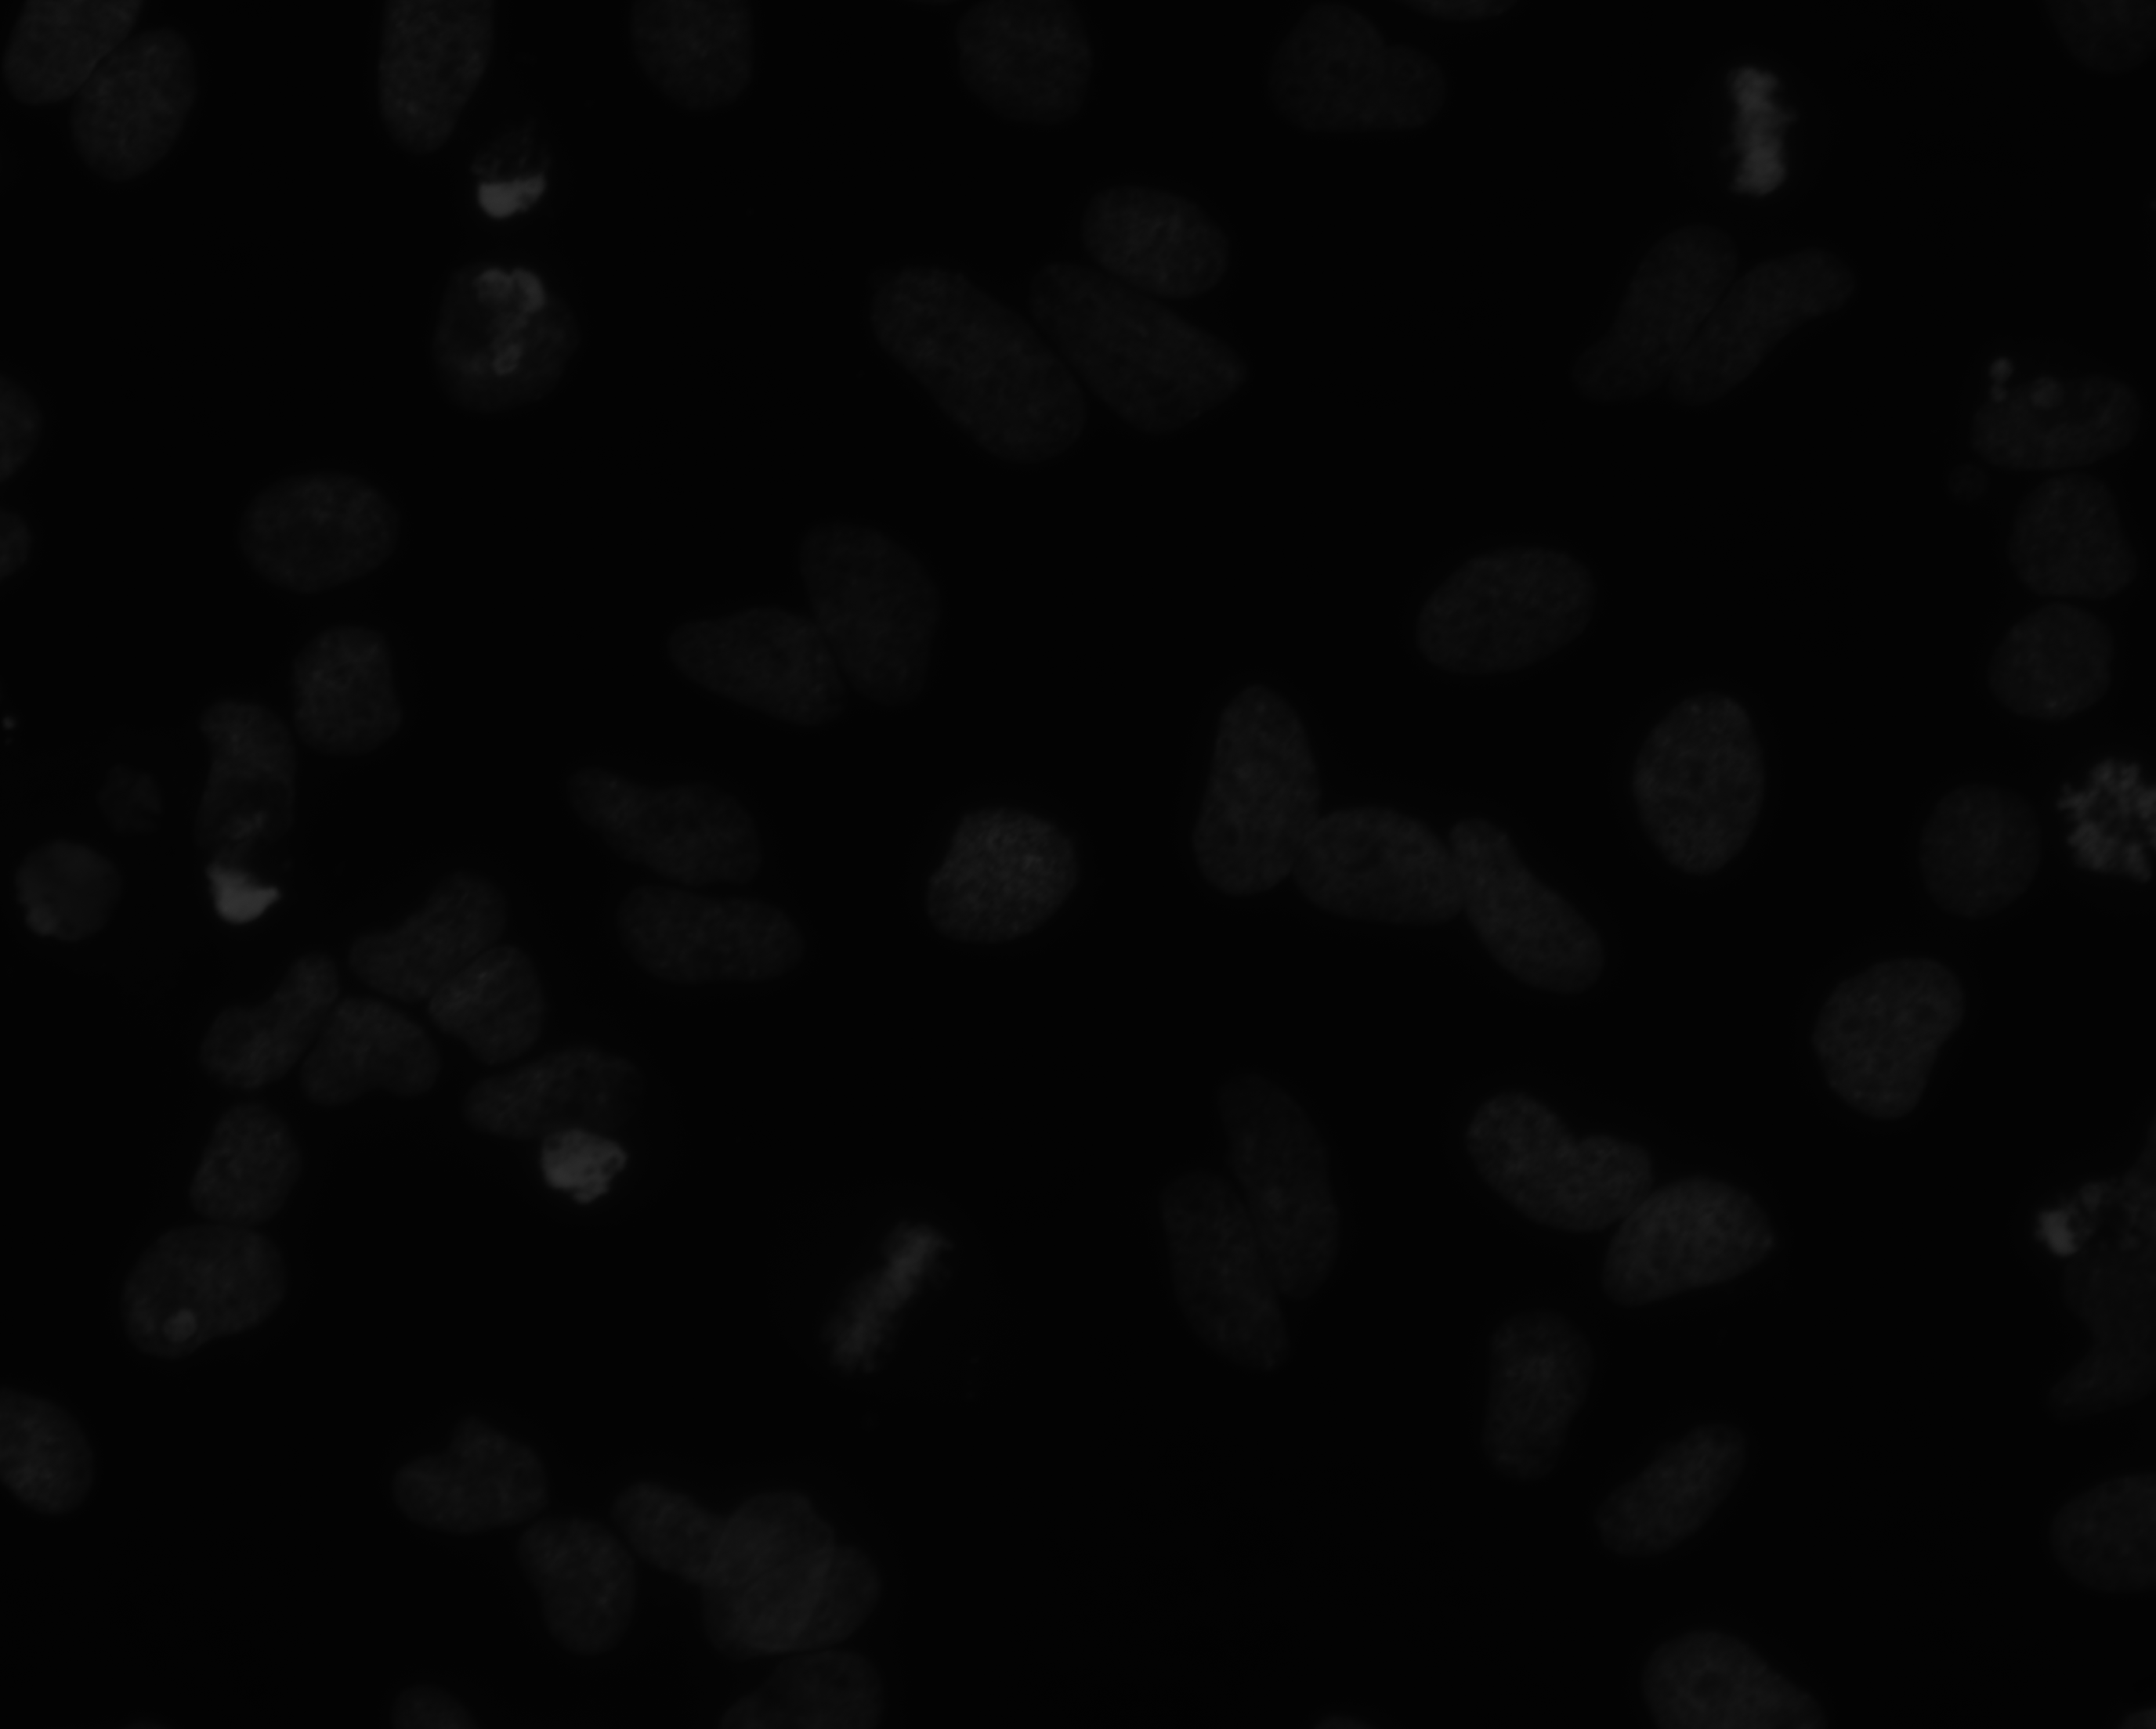
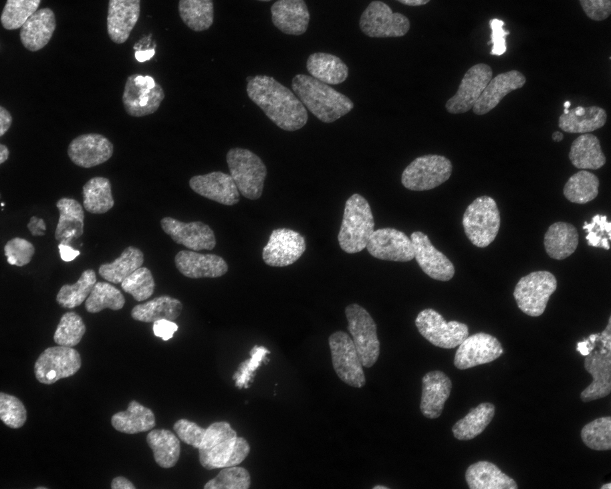

display contrast explained
12-bit
Information displayed on a monitor (or perceived by your eyes) is limited

Slide 42
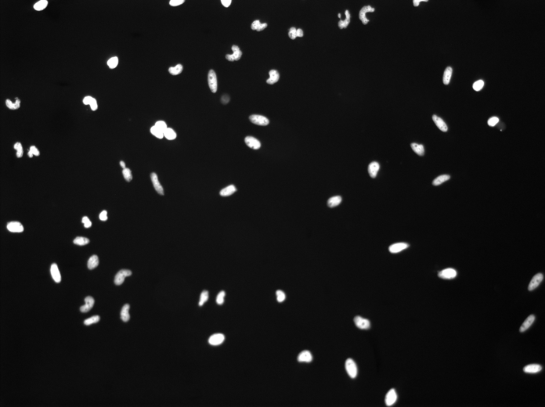
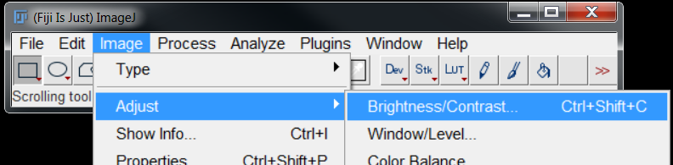
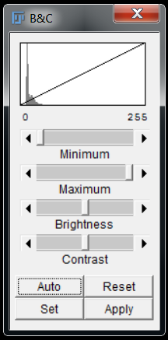

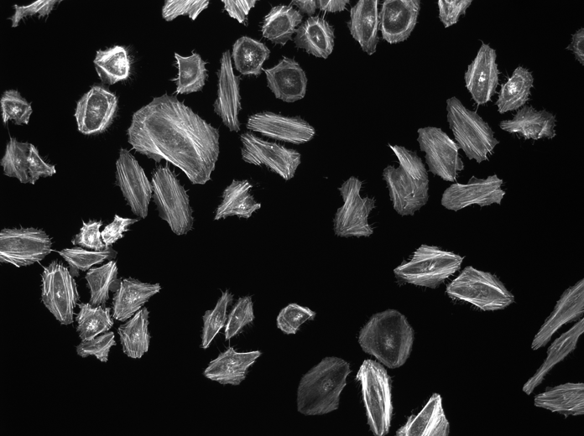
Adjust Contrast to see data

Slide 43
Look-Up Tables (LUTs)
By default, pixel values are mapped to grey levels…
0
64
128
192
255

Slide 44
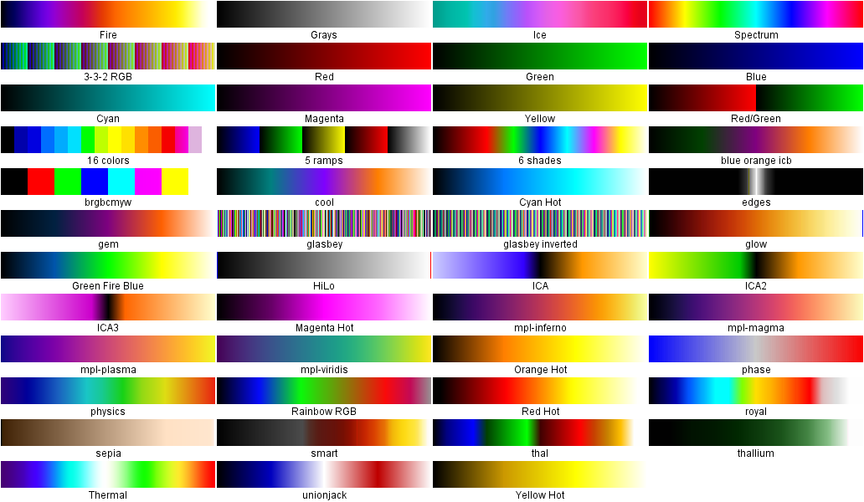
…but there is no reason why this has to be the case.

Slide 45
Coffee/Nap Time
Back @ 11:40

Slide 46
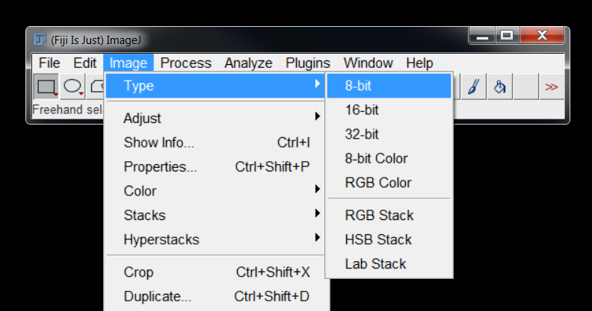
Bit Depth
Bits per pixel | Number of values | Range of values
8 | 2⁸ | 0 – 255
12 | 2¹² | 0 – 4,095
16 | 2¹⁶ | 0 – 65,535
32 | 2³² | 0 – 4,294,967,295
24-bit: Three 8-bit images interleaved
Greater bit depth means larger file sizes

Slide 47
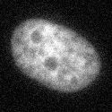

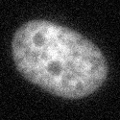
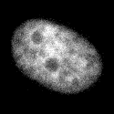




Reducing bit depth LOSES INFORMATION
Always acquire images with the highest possible bit depth
8-Bit: 256 Grey Levels
7-Bit: 128 Grey Levels
6-Bit: 64 Grey Levels
5-Bit: 32 Grey Levels
4-Bit: 16 Grey Levels
3-Bit: 8 Grey Levels
2-Bit: 4 Grey Levels
1-Bit: 2 Grey Levels

Slide 48

Quiz 2 – Understanding Pixel Values
There are 2 images in the Quiz 2 folder.
6 Points:
Which image has the greater bit depth?
2 Bonus Points:
What is the advantage of greater bit depth?
Notes:
1 point plus 1 bonus, 4 minutes

Slide 49




Image Compression
Lossless:
All image information is preserved
BMP, TIFF, PNG, Text
Larger file sizes
Lossy Compression: Anything that changes pixel values
Lossy:
Information irretrievably lost
JPEG, GIF
Small file sizes

Slide 50



Images are just numbers
The human brain is excellent at pattern matching…
…but this can result in us seeing “patterns” that don’t really exist
“Solutions to image analysis problems often appear simple, particularly when easily accomplished by the human visual system, which is complex and poorly understood.”

Slide 51


This can cause problems…
Pareidolia: a psychological phenomenon whereby the mind perceives familiar patterns in unstructured stimuli
1976, Viking 1
2001, Mars Global Surveyor

Slide 52




Which nucleus is brighter?
Same Intensity
Which centre circle is bigger?

Slide 53

What’s your point dave?!?!?
People will very often design an analysis pipeline to confirm what they think they see visually….
…which often results in significant frustration and/or disappointment.
Expected Result: Humanoids on Mars
Actual Result: Big Rock

Slide 54

Histograms
A graphical representation of the distribution of numerical data

Slide 55




Interpreting Histograms

Slide 56



High Average: 48,200
Low Average: 29,700
Ratio: 1.6
High Average: 59,400
Low Average: 45,700
Ratio: 1.3
High Average: 40,200
Low Average: 12,600
Ratio: 3.2

Slide 57



Interpreting Histograms Further
“Foreground”
“Background”
Can be exploited for segmentation

Slide 58

What is image segmentation?
Background labelled white (255)
Background
Foreground labelled black (0)
Foreground
Process of dividing image into regions
Assigning labels to each pixel
“Binary” or “Mask” Image

Slide 59


Masks can be black on white or white on black

Slide 60








Background
255
Foreground
0
$$T> \frac{\text{Average} \text{of} \text{Foreground} \text{Pixels}+\text{Average} \text{of} \text{Background} \text{Pixels}}{2}$$
FIJI has several variations on this algorithm

Slide 61



Click “Apply” to generate the binary image

Slide 62
Demo 2 – Thresholding
Conversion of grey image to binary
Illustrate different algorithms

Slide 63

Quiz 3 – Thresholding
Open the image in the Quiz 3 folder.
8 Points:
Which thresholding method is most appropriate for separating all eight spots from the background?
Notes:
1 point, 4 minutes

Slide 64






Boundary between regions is ambiguous
Segmentation is always an estimate

Slide 65


background is a common obstacle
?

Slide 66



Background Subtraction

Slide 67

Demo 3 – Correcting Uneven Background
Background subtractor estimates background and subtracts from image
Investigate influence of filter radius

Slide 68
speckle noise can be problematic…
Filtering can be employed to improve segmentation

Slide 69

What is Filtering?
Simple arithmetic operations on small numbers of pixels

Slide 70
32 | 149 | 143 | 56 | 213 | 226
113 | 237 | 137 | 226 | 16 | 119
77 | 84 | 206 | 121 | 210 | 188
192 | 157 | 2 | 33 | 91 | 217
99 | 115 | 5 | 183 | 2 | 89
149 | 209 | 123 | 11 | 40 | 224
32 | 149 | 143 | 56 | 213 | 226
113 | 237 | 137 | 226 | 16 | 119
77 | 84 | 206 | 121 | 210 | 188
192 | 157 | 2 | 33 | 91 | 217
99 | 115 | 5 | 183 | 2 | 89
149 | 209 | 123 | 11 | 40 | 224
32 | 149 | 143 | 56 | 213 | 226
113 | 237 | 137 | 226 | 16 | 119
77 | 84 | 206 | 121 | 210 | 188
192 | 157 | 2 | 33 | 91 | 217
99 | 115 | 5 | 183 | 2 | 89
149 | 209 | 123 | 11 | 40 | 224
 |  |  | 94.8
 |  |  | 121.8
Radius
Image Mean: 124.8
Larger filter radius results in less sensitive filter – less change between pixels

Slide 71
Mean Filtering with Radius = 1 Pixel
102 | 103 | 101 | 104 | 101 | 103 | 99 | 102 | 102 | 102 | 100 | 103 | 100 | 102 | 104 | 102 | 103 | 104 | 103 | 103 | 102 | 102 | 101 | 100 | 97
104 | 105 | 104 | 101 | 103 | 103 | 105 | 105 | 105 | 101 | 106 | 107 | 102 | 101 | 104 | 103 | 100 | 102 | 101 | 103 | 103 | 102 | 102 | 100 | 103
103 | 100 | 101 | 103 | 102 | 105 | 101 | 103 | 103 | 102 | 103 | 104 | 103 | 103 | 105 | 101 | 100 | 101 | 105 | 104 | 102 | 100 | 106 | 102 | 101
103 | 102 | 102 | 103 | 102 | 104 | 104 | 103 | 102 | 109 | 102 | 104 | 104 | 103 | 104 | 102 | 105 | 100 | 102 | 103 | 105 | 98 | 100 | 104 | 104
101 | 103 | 104 | 105 | 103 | 103 | 105 | 105 | 103 | 100 | 105 | 101 | 102 | 103 | 100 | 105 | 99 | 106 | 102 | 103 | 102 | 102 | 99 | 103 | 105
103 | 103 | 102 | 101 | 102 | 102 | 99 | 103 | 103 | 103 | 103 | 101 | 103 | 101 | 107 | 102 | 103 | 100 | 105 | 102 | 101 | 105 | 101 | 104 | 102
103 | 101 | 102 | 103 | 105 | 102 | 101 | 103 | 103 | 101 | 103 | 101 | 99 | 102 | 102 | 103 | 100 | 101 | 106 | 104 | 101 | 102 | 103 | 101 | 104
104 | 104 | 103 | 103 | 104 | 104 | 103 | 107 | 102 | 102 | 101 | 100 | 100 | 109 | 102 | 102 | 102 | 101 | 104 | 102 | 104 | 105 | 105 | 108 | 110
101 | 105 | 101 | 102 | 103 | 104 | 103 | 103 | 104 | 103 | 103 | 102 | 107 | 105 | 103 | 105 | 104 | 107 | 101 | 100 | 101 | 109 | 111 | 116 | 120
101 | 106 | 103 | 102 | 101 | 104 | 104 | 103 | 102 | 102 | 103 | 102 | 101 | 104 | 101 | 104 | 101 | 101 | 102 | 107 | 111 | 118 | 124 | 141 | 141
103 | 103 | 101 | 100 | 103 | 105 | 102 | 102 | 102 | 102 | 101 | 103 | 104 | 102 | 100 | 105 | 104 | 108 | 106 | 109 | 129 | 153 | 134 | 126 | 138
104 | 104 | 103 | 101 | 102 | 104 | 103 | 104 | 102 | 102 | 104 | 103 | 102 | 104 | 103 | 104 | 106 | 114 | 120 | 109 | 136 | 144 | 116 | 125 | 133
101 | 102 | 103 | 102 | 100 | 101 | 103 | 101 | 111 | 105 | 104 | 102 | 101 | 100 | 103 | 107 | 112 | 114 | 127 | 122 | 127 | 134 | 122 | 137 | 145
100 | 102 | 102 | 103 | 103 | 102 | 101 | 100 | 102 | 103 | 108 | 101 | 103 | 101 | 99 | 109 | 110 | 125 | 133 | 128 | 144 | 137 | 122 | 142 | 147
104 | 100 | 103 | 102 | 106 | 102 | 102 | 107 | 102 | 104 | 103 | 104 | 105 | 106 | 105 | 120 | 118 | 128 | 133 | 126 | 136 | 135 | 130 | 126 | 137
102 | 101 | 101 | 102 | 103 | 101 | 99 | 112 | 102 | 103 | 106 | 103 | 100 | 117 | 114 | 130 | 123 | 130 | 124 | 123 | 119 | 135 | 131 | 120 | 131
103 | 105 | 103 | 103 | 101 | 100 | 100 | 106 | 102 | 102 | 102 | 105 | 116 | 115 | 118 | 124 | 134 | 126 | 141 | 123 | 127 | 139 | 115 | 136 | 120
102 | 103 | 102 | 104 | 104 | 106 | 103 | 103 | 103 | 104 | 103 | 113 | 118 | 115 | 130 | 135 | 135 | 132 | 123 | 131 | 136 | 137 | 120 | 113 | 113
105 | 104 | 102 | 104 | 104 | 105 | 101 | 105 | 97 | 101 | 105 | 117 | 119 | 121 | 138 | 126 | 128 | 142 | 119 | 117 | 129 | 121 | 122 | 120 | 129
103 | 101 | 102 | 97 | 102 | 105 | 104 | 104 | 105 | 107 | 114 | 136 | 129 | 133 | 133 | 130 | 126 | 135 | 131 | 122 | 131 | 134 | 124 | 136 | 144
104 | 102 | 103 | 102 | 103 | 101 | 100 | 101 | 102 | 117 | 120 | 132 | 131 | 132 | 133 | 129 | 148 | 132 | 124 | 122 | 133 | 128 | 132 | 132 | 129
101 | 104 | 110 | 103 | 106 | 105 | 102 | 105 | 107 | 124 | 121 | 120 | 126 | 120 | 127 | 136 | 145 | 130 | 135 | 137 | 124 | 128 | 128 | 136 | 128
105 | 104 | 102 | 100 | 101 | 102 | 102 | 109 | 112 | 120 | 122 | 120 | 116 | 123 | 126 | 145 | 130 | 126 | 126 | 128 | 144 | 141 | 151 | 139 | 129
102 | 104 | 103 | 104 | 101 | 100 | 103 | 109 | 116 | 118 | 101 | 135 | 127 | 131 | 133 | 137 | 131 | 123 | 126 | 129 | 157 | 131 | 152 | 132 | 125
103 | 102 | 105 | 103 | 102 | 100 | 108 | 111 | 122 | 137 | 127 | 128 | 139 | 132 | 128 | 124 | 123 | 127 | 137 | 128 | 134 | 133 | 116 | 119 | 121
 | 103
 | 103 | 102
 | 103 | 102 | 102
103 | 103 | 103 | 102 | 103 | 102 | 102 | 102 | 103 | 102 | 103 | 102 | 102 | 102 | 103 | 103 | 103 | 103 | 103 | 103 | 102 | 102 | 101 | 100 | 101
103 | 103 | 102 | 102 | 103 | 102 | 103 | 103 | 103 | 103 | 103 | 103 | 103 | 103 | 103 | 102 | 102 | 102 | 103 | 103 | 102 | 102 | 102 | 101 | 102
103 | 103 | 102 | 102 | 103 | 103 | 104 | 103 | 104 | 104 | 104 | 104 | 103 | 103 | 103 | 103 | 102 | 102 | 102 | 103 | 102 | 102 | 102 | 102 | 102
102 | 102 | 103 | 103 | 103 | 103 | 104 | 103 | 103 | 103 | 103 | 103 | 103 | 103 | 103 | 102 | 102 | 102 | 103 | 103 | 102 | 102 | 102 | 103 | 103
102 | 103 | 103 | 103 | 103 | 103 | 103 | 103 | 103 | 103 | 103 | 103 | 102 | 103 | 103 | 103 | 102 | 102 | 103 | 103 | 102 | 101 | 102 | 102 | 104
102 | 102 | 103 | 103 | 103 | 102 | 103 | 103 | 103 | 103 | 102 | 102 | 101 | 102 | 103 | 102 | 102 | 102 | 103 | 103 | 102 | 102 | 102 | 102 | 104
103 | 103 | 102 | 103 | 103 | 102 | 103 | 103 | 103 | 102 | 102 | 101 | 102 | 103 | 103 | 103 | 102 | 102 | 103 | 103 | 103 | 103 | 104 | 104 | 106
103 | 103 | 103 | 103 | 103 | 103 | 103 | 103 | 103 | 102 | 102 | 102 | 103 | 103 | 104 | 103 | 103 | 103 | 103 | 103 | 103 | 105 | 107 | 109 | 112
103 | 103 | 103 | 102 | 103 | 103 | 104 | 103 | 103 | 102 | 102 | 102 | 103 | 104 | 104 | 103 | 103 | 103 | 103 | 104 | 106 | 110 | 115 | 120 | 123
103 | 103 | 103 | 102 | 103 | 103 | 103 | 103 | 103 | 102 | 102 | 103 | 103 | 103 | 103 | 103 | 104 | 104 | 105 | 107 | 115 | 121 | 126 | 128 | 131
103 | 103 | 103 | 102 | 102 | 103 | 103 | 103 | 102 | 102 | 102 | 103 | 103 | 102 | 103 | 103 | 105 | 107 | 108 | 114 | 124 | 129 | 131 | 131 | 135
103 | 103 | 102 | 102 | 102 | 103 | 103 | 103 | 103 | 104 | 103 | 103 | 102 | 102 | 103 | 105 | 108 | 112 | 114 | 121 | 129 | 133 | 132 | 131 | 136
102 | 102 | 102 | 102 | 102 | 102 | 102 | 103 | 103 | 105 | 104 | 103 | 102 | 102 | 103 | 106 | 111 | 118 | 121 | 127 | 131 | 131 | 131 | 132 | 140
102 | 102 | 102 | 103 | 102 | 102 | 102 | 103 | 104 | 105 | 104 | 103 | 103 | 103 | 106 | 109 | 116 | 122 | 126 | 131 | 132 | 132 | 132 | 134 | 139
102 | 102 | 102 | 103 | 103 | 102 | 103 | 103 | 104 | 104 | 104 | 104 | 104 | 106 | 111 | 114 | 121 | 125 | 128 | 130 | 131 | 132 | 131 | 132 | 135
103 | 102 | 102 | 103 | 102 | 102 | 103 | 104 | 104 | 103 | 104 | 105 | 108 | 111 | 117 | 121 | 126 | 129 | 128 | 128 | 129 | 130 | 130 | 127 | 129
103 | 102 | 103 | 103 | 103 | 102 | 103 | 103 | 104 | 103 | 105 | 107 | 111 | 116 | 122 | 127 | 130 | 130 | 128 | 127 | 130 | 129 | 127 | 122 | 124
104 | 103 | 103 | 103 | 103 | 103 | 103 | 102 | 103 | 102 | 106 | 111 | 115 | 121 | 125 | 130 | 131 | 131 | 128 | 127 | 129 | 127 | 125 | 121 | 123
103 | 103 | 102 | 102 | 103 | 104 | 104 | 103 | 103 | 104 | 111 | 117 | 122 | 126 | 129 | 131 | 132 | 130 | 128 | 127 | 129 | 128 | 125 | 125 | 127
103 | 103 | 102 | 102 | 103 | 103 | 103 | 102 | 104 | 108 | 117 | 123 | 128 | 130 | 131 | 132 | 133 | 132 | 127 | 125 | 126 | 128 | 128 | 130 | 132
103 | 103 | 103 | 103 | 103 | 103 | 103 | 103 | 108 | 113 | 121 | 125 | 129 | 129 | 130 | 134 | 135 | 134 | 130 | 129 | 129 | 129 | 131 | 132 | 134
103 | 104 | 103 | 103 | 103 | 102 | 103 | 104 | 111 | 116 | 122 | 123 | 124 | 126 | 130 | 135 | 136 | 133 | 129 | 130 | 132 | 134 | 135 | 134 | 132
103 | 104 | 104 | 103 | 102 | 102 | 104 | 107 | 113 | 116 | 120 | 121 | 124 | 125 | 131 | 134 | 134 | 130 | 129 | 134 | 135 | 140 | 138 | 136 | 131
103 | 103 | 103 | 102 | 101 | 102 | 105 | 110 | 117 | 119 | 123 | 124 | 128 | 128 | 131 | 131 | 130 | 128 | 128 | 134 | 136 | 140 | 135 | 132 | 128
103 | 103 | 104 | 103 | 102 | 104 | 107 | 113 | 120 | 122 | 128 | 128 | 132 | 131 | 130 | 129 | 127 | 129 | 128 | 131 | 128 | 129 | 125 | 123 | 121
Input
Output

Slide 72
Mean Filtering with Radius = 3 Pixels
102 | 103 | 101 | 104 | 101 | 103 | 99 | 102 | 102 | 102 | 100 | 103 | 100 | 102 | 104 | 102 | 103 | 104 | 103 | 103 | 102 | 102 | 101 | 100 | 97
104 | 105 | 104 | 101 | 103 | 103 | 105 | 105 | 105 | 101 | 106 | 107 | 102 | 101 | 104 | 103 | 100 | 102 | 101 | 103 | 103 | 102 | 102 | 100 | 103
103 | 100 | 101 | 103 | 102 | 105 | 101 | 103 | 103 | 102 | 103 | 104 | 103 | 103 | 105 | 101 | 100 | 101 | 105 | 104 | 102 | 100 | 106 | 102 | 101
103 | 102 | 102 | 103 | 102 | 104 | 104 | 103 | 102 | 109 | 102 | 104 | 104 | 103 | 104 | 102 | 105 | 100 | 102 | 103 | 105 | 98 | 100 | 104 | 104
101 | 103 | 104 | 105 | 103 | 103 | 105 | 105 | 103 | 100 | 105 | 101 | 102 | 103 | 100 | 105 | 99 | 106 | 102 | 103 | 102 | 102 | 99 | 103 | 105
103 | 103 | 102 | 101 | 102 | 102 | 99 | 103 | 103 | 103 | 103 | 101 | 103 | 101 | 107 | 102 | 103 | 100 | 105 | 102 | 101 | 105 | 101 | 104 | 102
103 | 101 | 102 | 103 | 105 | 102 | 101 | 103 | 103 | 101 | 103 | 101 | 99 | 102 | 102 | 103 | 100 | 101 | 106 | 104 | 101 | 102 | 103 | 101 | 104
104 | 104 | 103 | 103 | 104 | 104 | 103 | 107 | 102 | 102 | 101 | 100 | 100 | 109 | 102 | 102 | 102 | 101 | 104 | 102 | 104 | 105 | 105 | 108 | 110
101 | 105 | 101 | 102 | 103 | 104 | 103 | 103 | 104 | 103 | 103 | 102 | 107 | 105 | 103 | 105 | 104 | 107 | 101 | 100 | 101 | 109 | 111 | 116 | 120
101 | 106 | 103 | 102 | 101 | 104 | 104 | 103 | 102 | 102 | 103 | 102 | 101 | 104 | 101 | 104 | 101 | 101 | 102 | 107 | 111 | 118 | 124 | 141 | 141
103 | 103 | 101 | 100 | 103 | 105 | 102 | 102 | 102 | 102 | 101 | 103 | 104 | 102 | 100 | 105 | 104 | 108 | 106 | 109 | 129 | 153 | 134 | 126 | 138
104 | 104 | 103 | 101 | 102 | 104 | 103 | 104 | 102 | 102 | 104 | 103 | 102 | 104 | 103 | 104 | 106 | 114 | 120 | 109 | 136 | 144 | 116 | 125 | 133
101 | 102 | 103 | 102 | 100 | 101 | 103 | 101 | 111 | 105 | 104 | 102 | 101 | 100 | 103 | 107 | 112 | 114 | 127 | 122 | 127 | 134 | 122 | 137 | 145
100 | 102 | 102 | 103 | 103 | 102 | 101 | 100 | 102 | 103 | 108 | 101 | 103 | 101 | 99 | 109 | 110 | 125 | 133 | 128 | 144 | 137 | 122 | 142 | 147
104 | 100 | 103 | 102 | 106 | 102 | 102 | 107 | 102 | 104 | 103 | 104 | 105 | 106 | 105 | 120 | 118 | 128 | 133 | 126 | 136 | 135 | 130 | 126 | 137
102 | 101 | 101 | 102 | 103 | 101 | 99 | 112 | 102 | 103 | 106 | 103 | 100 | 117 | 114 | 130 | 123 | 130 | 124 | 123 | 119 | 135 | 131 | 120 | 131
103 | 105 | 103 | 103 | 101 | 100 | 100 | 106 | 102 | 102 | 102 | 105 | 116 | 115 | 118 | 124 | 134 | 126 | 141 | 123 | 127 | 139 | 115 | 136 | 120
102 | 103 | 102 | 104 | 104 | 106 | 103 | 103 | 103 | 104 | 103 | 113 | 118 | 115 | 130 | 135 | 135 | 132 | 123 | 131 | 136 | 137 | 120 | 113 | 113
105 | 104 | 102 | 104 | 104 | 105 | 101 | 105 | 97 | 101 | 105 | 117 | 119 | 121 | 138 | 126 | 128 | 142 | 119 | 117 | 129 | 121 | 122 | 120 | 129
103 | 101 | 102 | 97 | 102 | 105 | 104 | 104 | 105 | 107 | 114 | 136 | 129 | 133 | 133 | 130 | 126 | 135 | 131 | 122 | 131 | 134 | 124 | 136 | 144
104 | 102 | 103 | 102 | 103 | 101 | 100 | 101 | 102 | 117 | 120 | 132 | 131 | 132 | 133 | 129 | 148 | 132 | 124 | 122 | 133 | 128 | 132 | 132 | 129
101 | 104 | 110 | 103 | 106 | 105 | 102 | 105 | 107 | 124 | 121 | 120 | 126 | 120 | 127 | 136 | 145 | 130 | 135 | 137 | 124 | 128 | 128 | 136 | 128
105 | 104 | 102 | 100 | 101 | 102 | 102 | 109 | 112 | 120 | 122 | 120 | 116 | 123 | 126 | 145 | 130 | 126 | 126 | 128 | 144 | 141 | 151 | 139 | 129
102 | 104 | 103 | 104 | 101 | 100 | 103 | 109 | 116 | 118 | 101 | 135 | 127 | 131 | 133 | 137 | 131 | 123 | 126 | 129 | 157 | 131 | 152 | 132 | 125
103 | 102 | 105 | 103 | 102 | 100 | 108 | 111 | 122 | 137 | 127 | 128 | 139 | 132 | 128 | 124 | 123 | 127 | 137 | 128 | 134 | 133 | 116 | 119 | 121
 |  |  | 103
 |  |  | 103 | 103
 |  |  | 103 | 103 | 103
103 | 102 | 102 | 102 | 102 | 102 | 102 | 102 | 102 | 102 | 102 | 102 | 103 | 103 | 103 | 103 | 103 | 103 | 103 | 103 | 102 | 102 | 102 | 102 | 102
103 | 103 | 103 | 103 | 103 | 103 | 103 | 103 | 103 | 103 | 103 | 103 | 103 | 103 | 103 | 102 | 103 | 103 | 103 | 102 | 102 | 102 | 102 | 102 | 102
103 | 103 | 103 | 103 | 103 | 103 | 103 | 103 | 103 | 103 | 103 | 103 | 103 | 103 | 103 | 103 | 103 | 103 | 102 | 102 | 102 | 102 | 102 | 102 | 102
103 | 103 | 103 | 103 | 103 | 103 | 103 | 103 | 103 | 103 | 103 | 103 | 103 | 103 | 103 | 102 | 103 | 103 | 102 | 102 | 102 | 102 | 102 | 103 | 103
103 | 103 | 103 | 103 | 103 | 103 | 103 | 103 | 103 | 103 | 103 | 103 | 103 | 103 | 103 | 102 | 102 | 103 | 102 | 102 | 103 | 103 | 103 | 103 | 104
103 | 103 | 103 | 103 | 103 | 103 | 103 | 103 | 103 | 103 | 102 | 103 | 103 | 103 | 103 | 103 | 103 | 103 | 103 | 102 | 103 | 103 | 104 | 105 | 106
103 | 103 | 103 | 103 | 103 | 103 | 103 | 103 | 103 | 102 | 103 | 103 | 103 | 103 | 102 | 103 | 103 | 103 | 103 | 103 | 104 | 105 | 106 | 109 | 110
103 | 103 | 103 | 103 | 103 | 103 | 103 | 103 | 103 | 102 | 103 | 103 | 103 | 102 | 103 | 103 | 103 | 103 | 104 | 105 | 107 | 109 | 111 | 113 | 116
103 | 103 | 103 | 103 | 103 | 103 | 103 | 103 | 103 | 103 | 103 | 102 | 102 | 103 | 103 | 103 | 104 | 104 | 106 | 108 | 111 | 114 | 116 | 118 | 122
102 | 102 | 103 | 103 | 103 | 103 | 103 | 103 | 103 | 103 | 103 | 103 | 103 | 103 | 103 | 104 | 105 | 106 | 110 | 113 | 115 | 117 | 121 | 124 | 127
102 | 102 | 103 | 103 | 103 | 102 | 103 | 103 | 103 | 103 | 103 | 103 | 103 | 103 | 104 | 105 | 107 | 110 | 113 | 116 | 119 | 122 | 126 | 130 | 133
102 | 102 | 102 | 103 | 103 | 103 | 103 | 103 | 103 | 103 | 103 | 103 | 103 | 104 | 105 | 107 | 109 | 113 | 117 | 120 | 123 | 127 | 130 | 133 | 135
102 | 102 | 102 | 102 | 102 | 103 | 103 | 103 | 103 | 103 | 103 | 103 | 103 | 105 | 107 | 110 | 113 | 116 | 120 | 123 | 127 | 130 | 133 | 135 | 135
102 | 102 | 102 | 102 | 102 | 103 | 103 | 103 | 103 | 103 | 103 | 104 | 105 | 107 | 109 | 113 | 116 | 120 | 123 | 126 | 129 | 131 | 133 | 134 | 134
102 | 102 | 102 | 102 | 102 | 103 | 103 | 103 | 103 | 103 | 105 | 105 | 107 | 109 | 113 | 116 | 120 | 123 | 126 | 128 | 130 | 131 | 131 | 131 | 132
102 | 103 | 103 | 102 | 103 | 103 | 103 | 103 | 103 | 104 | 106 | 107 | 110 | 113 | 116 | 120 | 123 | 125 | 128 | 129 | 129 | 129 | 129 | 130 | 131
103 | 103 | 103 | 102 | 103 | 103 | 103 | 103 | 103 | 105 | 107 | 110 | 113 | 117 | 120 | 123 | 125 | 127 | 129 | 129 | 128 | 127 | 128 | 128 | 131
103 | 103 | 103 | 103 | 103 | 103 | 103 | 103 | 105 | 107 | 110 | 113 | 117 | 120 | 123 | 126 | 128 | 129 | 128 | 129 | 128 | 127 | 127 | 129 | 130
103 | 103 | 103 | 103 | 103 | 103 | 103 | 104 | 107 | 109 | 112 | 116 | 119 | 123 | 127 | 129 | 130 | 130 | 130 | 128 | 128 | 127 | 128 | 129 | 130
103 | 103 | 103 | 103 | 103 | 103 | 104 | 105 | 108 | 111 | 115 | 118 | 121 | 125 | 129 | 130 | 131 | 131 | 130 | 130 | 129 | 129 | 129 | 130 | 132
103 | 103 | 103 | 103 | 103 | 103 | 104 | 107 | 110 | 112 | 116 | 120 | 124 | 128 | 130 | 132 | 131 | 130 | 130 | 131 | 131 | 132 | 131 | 132 | 132
103 | 103 | 103 | 103 | 103 | 103 | 105 | 108 | 111 | 115 | 118 | 122 | 126 | 130 | 130 | 130 | 131 | 131 | 132 | 132 | 132 | 132 | 132 | 132 | 133
103 | 103 | 103 | 103 | 103 | 104 | 107 | 109 | 113 | 117 | 122 | 125 | 128 | 129 | 130 | 130 | 130 | 132 | 132 | 132 | 131 | 130 | 131 | 132 | 132
103 | 103 | 103 | 103 | 104 | 106 | 108 | 111 | 115 | 119 | 122 | 125 | 128 | 129 | 130 | 130 | 131 | 131 | 130 | 129 | 129 | 129 | 128 | 128 | 129
103 | 103 | 103 | 103 | 104 | 107 | 110 | 112 | 117 | 121 | 124 | 126 | 128 | 129 | 130 | 131 | 130 | 129 | 127 | 127 | 127 | 125 | 125 | 125 | 125
Input
Output

Slide 73
Effect of Mean Filter radius
103 | 103 | 103 | 102 | 103 | 102 | 102 | 102 | 103 | 102 | 103 | 102 | 102 | 102 | 103 | 103 | 103 | 103 | 103 | 103 | 102 | 102 | 101 | 100 | 101
103 | 103 | 102 | 102 | 103 | 102 | 103 | 103 | 103 | 103 | 103 | 103 | 103 | 103 | 103 | 102 | 102 | 102 | 103 | 103 | 102 | 102 | 102 | 101 | 102
103 | 103 | 102 | 102 | 103 | 103 | 104 | 103 | 104 | 104 | 104 | 104 | 103 | 103 | 103 | 103 | 102 | 102 | 102 | 103 | 102 | 102 | 102 | 102 | 102
102 | 102 | 103 | 103 | 103 | 103 | 104 | 103 | 103 | 103 | 103 | 103 | 103 | 103 | 103 | 102 | 102 | 102 | 103 | 103 | 102 | 102 | 102 | 103 | 103
102 | 103 | 103 | 103 | 103 | 103 | 103 | 103 | 103 | 103 | 103 | 103 | 102 | 103 | 103 | 103 | 102 | 102 | 103 | 103 | 102 | 101 | 102 | 102 | 104
102 | 102 | 103 | 103 | 103 | 102 | 103 | 103 | 103 | 103 | 102 | 102 | 101 | 102 | 103 | 102 | 102 | 102 | 103 | 103 | 102 | 102 | 102 | 102 | 104
103 | 103 | 102 | 103 | 103 | 102 | 103 | 103 | 103 | 102 | 102 | 101 | 102 | 103 | 103 | 103 | 102 | 102 | 103 | 103 | 103 | 103 | 104 | 104 | 106
103 | 103 | 103 | 103 | 103 | 103 | 103 | 103 | 103 | 102 | 102 | 102 | 103 | 103 | 104 | 103 | 103 | 103 | 103 | 103 | 103 | 105 | 107 | 109 | 112
103 | 103 | 103 | 102 | 103 | 103 | 104 | 103 | 103 | 102 | 102 | 102 | 103 | 104 | 104 | 103 | 103 | 103 | 103 | 104 | 106 | 110 | 115 | 120 | 123
103 | 103 | 103 | 102 | 103 | 103 | 103 | 103 | 103 | 102 | 102 | 103 | 103 | 103 | 103 | 103 | 104 | 104 | 105 | 107 | 115 | 121 | 126 | 128 | 131
103 | 103 | 103 | 102 | 102 | 103 | 103 | 103 | 102 | 102 | 102 | 103 | 103 | 102 | 103 | 103 | 105 | 107 | 108 | 114 | 124 | 129 | 131 | 131 | 135
103 | 103 | 102 | 102 | 102 | 103 | 103 | 103 | 103 | 104 | 103 | 103 | 102 | 102 | 103 | 105 | 108 | 112 | 114 | 121 | 129 | 133 | 132 | 131 | 136
102 | 102 | 102 | 102 | 102 | 102 | 102 | 103 | 103 | 105 | 104 | 103 | 102 | 102 | 103 | 106 | 111 | 118 | 121 | 127 | 131 | 131 | 131 | 132 | 140
102 | 102 | 102 | 103 | 102 | 102 | 102 | 103 | 104 | 105 | 104 | 103 | 103 | 103 | 106 | 109 | 116 | 122 | 126 | 131 | 132 | 132 | 132 | 134 | 139
102 | 102 | 102 | 103 | 103 | 102 | 103 | 103 | 104 | 104 | 104 | 104 | 104 | 106 | 111 | 114 | 121 | 125 | 128 | 130 | 131 | 132 | 131 | 132 | 135
103 | 102 | 102 | 103 | 102 | 102 | 103 | 104 | 104 | 103 | 104 | 105 | 108 | 111 | 117 | 121 | 126 | 129 | 128 | 128 | 129 | 130 | 130 | 127 | 129
103 | 102 | 103 | 103 | 103 | 102 | 103 | 103 | 104 | 103 | 105 | 107 | 111 | 116 | 122 | 127 | 130 | 130 | 128 | 127 | 130 | 129 | 127 | 122 | 124
104 | 103 | 103 | 103 | 103 | 103 | 103 | 102 | 103 | 102 | 106 | 111 | 115 | 121 | 125 | 130 | 131 | 131 | 128 | 127 | 129 | 127 | 125 | 121 | 123
103 | 103 | 102 | 102 | 103 | 104 | 104 | 103 | 103 | 104 | 111 | 117 | 122 | 126 | 129 | 131 | 132 | 130 | 128 | 127 | 129 | 128 | 125 | 125 | 127
103 | 103 | 102 | 102 | 103 | 103 | 103 | 102 | 104 | 108 | 117 | 123 | 128 | 130 | 131 | 132 | 133 | 132 | 127 | 125 | 126 | 128 | 128 | 130 | 132
103 | 103 | 103 | 103 | 103 | 103 | 103 | 103 | 108 | 113 | 121 | 125 | 129 | 129 | 130 | 134 | 135 | 134 | 130 | 129 | 129 | 129 | 131 | 132 | 134
103 | 104 | 103 | 103 | 103 | 102 | 103 | 104 | 111 | 116 | 122 | 123 | 124 | 126 | 130 | 135 | 136 | 133 | 129 | 130 | 132 | 134 | 135 | 134 | 132
103 | 104 | 104 | 103 | 102 | 102 | 104 | 107 | 113 | 116 | 120 | 121 | 124 | 125 | 131 | 134 | 134 | 130 | 129 | 134 | 135 | 140 | 138 | 136 | 131
103 | 103 | 103 | 102 | 101 | 102 | 105 | 110 | 117 | 119 | 123 | 124 | 128 | 128 | 131 | 131 | 130 | 128 | 128 | 134 | 136 | 140 | 135 | 132 | 128
103 | 103 | 104 | 103 | 102 | 104 | 107 | 113 | 120 | 122 | 128 | 128 | 132 | 131 | 130 | 129 | 127 | 129 | 128 | 131 | 128 | 129 | 125 | 123 | 121
103 | 102 | 102 | 102 | 102 | 102 | 102 | 102 | 102 | 102 | 102 | 102 | 103 | 103 | 103 | 103 | 103 | 103 | 103 | 103 | 102 | 102 | 102 | 102 | 102
103 | 103 | 103 | 103 | 103 | 103 | 103 | 103 | 103 | 103 | 103 | 103 | 103 | 103 | 103 | 102 | 103 | 103 | 103 | 102 | 102 | 102 | 102 | 102 | 102
103 | 103 | 103 | 103 | 103 | 103 | 103 | 103 | 103 | 103 | 103 | 103 | 103 | 103 | 103 | 103 | 103 | 103 | 102 | 102 | 102 | 102 | 102 | 102 | 102
103 | 103 | 103 | 103 | 103 | 103 | 103 | 103 | 103 | 103 | 103 | 103 | 103 | 103 | 103 | 102 | 103 | 103 | 102 | 102 | 102 | 102 | 102 | 103 | 103
103 | 103 | 103 | 103 | 103 | 103 | 103 | 103 | 103 | 103 | 103 | 103 | 103 | 103 | 103 | 102 | 102 | 103 | 102 | 102 | 103 | 103 | 103 | 103 | 104
103 | 103 | 103 | 103 | 103 | 103 | 103 | 103 | 103 | 103 | 102 | 103 | 103 | 103 | 103 | 103 | 103 | 103 | 103 | 102 | 103 | 103 | 104 | 105 | 106
103 | 103 | 103 | 103 | 103 | 103 | 103 | 103 | 103 | 102 | 103 | 103 | 103 | 103 | 102 | 103 | 103 | 103 | 103 | 103 | 104 | 105 | 106 | 109 | 110
103 | 103 | 103 | 103 | 103 | 103 | 103 | 103 | 103 | 102 | 103 | 103 | 103 | 102 | 103 | 103 | 103 | 103 | 104 | 105 | 107 | 109 | 111 | 113 | 116
103 | 103 | 103 | 103 | 103 | 103 | 103 | 103 | 103 | 103 | 103 | 102 | 102 | 103 | 103 | 103 | 104 | 104 | 106 | 108 | 111 | 114 | 116 | 118 | 122
102 | 102 | 103 | 103 | 103 | 103 | 103 | 103 | 103 | 103 | 103 | 103 | 103 | 103 | 103 | 104 | 105 | 106 | 110 | 113 | 115 | 117 | 121 | 124 | 127
102 | 102 | 103 | 103 | 103 | 102 | 103 | 103 | 103 | 103 | 103 | 103 | 103 | 103 | 104 | 105 | 107 | 110 | 113 | 116 | 119 | 122 | 126 | 130 | 133
102 | 102 | 102 | 103 | 103 | 103 | 103 | 103 | 103 | 103 | 103 | 103 | 103 | 104 | 105 | 107 | 109 | 113 | 117 | 120 | 123 | 127 | 130 | 133 | 135
102 | 102 | 102 | 102 | 102 | 103 | 103 | 103 | 103 | 103 | 103 | 103 | 103 | 105 | 107 | 110 | 113 | 116 | 120 | 123 | 127 | 130 | 133 | 135 | 135
102 | 102 | 102 | 102 | 102 | 103 | 103 | 103 | 103 | 103 | 103 | 104 | 105 | 107 | 109 | 113 | 116 | 120 | 123 | 126 | 129 | 131 | 133 | 134 | 134
102 | 102 | 102 | 102 | 102 | 103 | 103 | 103 | 103 | 103 | 105 | 105 | 107 | 109 | 113 | 116 | 120 | 123 | 126 | 128 | 130 | 131 | 131 | 131 | 132
102 | 103 | 103 | 102 | 103 | 103 | 103 | 103 | 103 | 104 | 106 | 107 | 110 | 113 | 116 | 120 | 123 | 125 | 128 | 129 | 129 | 129 | 129 | 130 | 131
103 | 103 | 103 | 102 | 103 | 103 | 103 | 103 | 103 | 105 | 107 | 110 | 113 | 117 | 120 | 123 | 125 | 127 | 129 | 129 | 128 | 127 | 128 | 128 | 131
103 | 103 | 103 | 103 | 103 | 103 | 103 | 103 | 105 | 107 | 110 | 113 | 117 | 120 | 123 | 126 | 128 | 129 | 128 | 129 | 128 | 127 | 127 | 129 | 130
103 | 103 | 103 | 103 | 103 | 103 | 103 | 104 | 107 | 109 | 112 | 116 | 119 | 123 | 127 | 129 | 130 | 130 | 130 | 128 | 128 | 127 | 128 | 129 | 130
103 | 103 | 103 | 103 | 103 | 103 | 104 | 105 | 108 | 111 | 115 | 118 | 121 | 125 | 129 | 130 | 131 | 131 | 130 | 130 | 129 | 129 | 129 | 130 | 132
103 | 103 | 103 | 103 | 103 | 103 | 104 | 107 | 110 | 112 | 116 | 120 | 124 | 128 | 130 | 132 | 131 | 130 | 130 | 131 | 131 | 132 | 131 | 132 | 132
103 | 103 | 103 | 103 | 103 | 103 | 105 | 108 | 111 | 115 | 118 | 122 | 126 | 130 | 130 | 130 | 131 | 131 | 132 | 132 | 132 | 132 | 132 | 132 | 133
103 | 103 | 103 | 103 | 103 | 104 | 107 | 109 | 113 | 117 | 122 | 125 | 128 | 129 | 130 | 130 | 130 | 132 | 132 | 132 | 131 | 130 | 131 | 132 | 132
103 | 103 | 103 | 103 | 104 | 106 | 108 | 111 | 115 | 119 | 122 | 125 | 128 | 129 | 130 | 130 | 131 | 131 | 130 | 129 | 129 | 129 | 128 | 128 | 129
103 | 103 | 103 | 103 | 104 | 107 | 110 | 112 | 117 | 121 | 124 | 126 | 128 | 129 | 130 | 131 | 130 | 129 | 127 | 127 | 127 | 125 | 125 | 125 | 125
Radius = 1
Radius = 3

Slide 74

MEAN Filtering “BLURS” Noise
But information is lost!

Slide 75




Median Filtering Removes outliers, Preserves Edges
Original
Corrupted with noise
Median filtered
Mean filtered

Slide 76




neither mean nor median is optimal
Filter should preserve information while removing noise
Gaussian filter “matches” Airy disc

Slide 77



Input
Mean
Gaussian
Unfiltered Output
Median
Filtered Output

Slide 78

Demo 3 - Filters
Notice effect of varying filter radius
Observe difference between mean and median filters

Slide 79
Quiz 4 - Filters
Open the image in the Quiz 4 folder
6 Points:
Find an appropriate filter type and radius to reveal the text – what does it say?
2 Bonus Points:
What would be an appropriate filter type and radius to enhance the blob?
Notes:
1 point plus 1 bonus, 5 minutes

Slide 80


Morphological Analysis
How do we extract numerical data from binary images?

Slide 81

Morphological Measures
Number of Objects
Area (A)
Perimeter (P)
Bounding Box
Circularity:
$$4π×\frac{A}{P^{2}}$$
Perfect Circle = 1.0

Slide 82


Morphological Analysis

Slide 83



Slide 84


0
0
255
0
0
0
0
Connected Components
0
0
0
0

Slide 85




Morphological Filtering
Erosion
Dilation
Erosion + Dilation = Opening

Slide 86




Morphological filters can be used to:
Remove small artefacts
Break “bridges”
Watershed: break apart touching cells

Slide 87

Demo 4 – working with binary images
Demo particle analyser and morphological filters
Show how to specify background colour for analyser

Slide 88
Lunch Time
Back @ 14:00

Slide 89
Attendance is being logged.
Please email me (david.barry@crick.ac.uk) to let me know you’re here!

Slide 90

Quiz 5 – measuring morphology
Open the image in the Quiz 5 folder.
8 Points:
What is the area of the object?
Notes:
1 point, 4 minutes

Slide 91
Challenge 1
15 Points:
Count the number of cells
15 Points:
Estimate the mean cell area
Note: You may find it helpful to duplicate and/or rename images as you work
Filter Noise
Segment Cells From Background
Specify Morphological Measurements
Image > Adjust > Threshold
Analyze > Set Measurements
Manipulate Segmentation
Process > Binary
Process > Filters
Quantify Morphology
Analyze > Analyze Particles
Notes:
8 points, 45 minutes

Slide 92

Solution to Challenge 1

Slide 93

How do parameter values affect the result?
$$N_{total}=100$$

Slide 94






Using morphological criteria

Slide 95





Alternative Approach: region-growing

Slide 96
Coffee/Nap Time
Back @ 15:20

Slide 97

Analysing multiple channels
What if we want to analyse protein expression?

Slide 98





Restrict measurements to within Regions of Interest (ROIs)
Generate an ROI
Apply ROI to image
Measure the pixel values in the image within the ROI

Slide 99


Connected components in binary images are regions
Masks and ROIS can be considered one and the same

Slide 100




Binary Mask
FIJI will always apply measurements to whatever image is specified here
Fluorescent Signal

Slide 101
Demo 5 – Quantifying Fluorescence
Demonstration of Particle Analyser’s ability to apply ROIs to measure grey levels

Slide 102
Challenge 2
8 Points:
What is the average GFP intensity in the nuclei?
2 Points:
Is this value representative of the population? Why?
Filter Noise
Segment nuclei from background
Image > Adjust > Threshold
Analyze > Set Measurements
Manipulate Segmentation
Process > Binary
Process > Filters
Quantify Morphology & Fluorescence
Analyze > Analyze Particles
Specify Measurements

Slide 103

What if we want to examine differences in protein expression…
…between here…
Require two different ROIs
Generate two different ROIs
Apply ROIs to image, one at a time
Measure the pixel values in the image within the ROIs
…and here?

Slide 104



Binary Mask of Cell
Binary Mask of Nucleus

Slide 105



Calculate difference between these…
…to produce this.

Slide 106
Challenge 3
8 Points:
Estimate the nuclear-to-cytoplasmic ratio of GFP expression
2 Points:
Why is it a good idea to express the difference in protein localisation as a ratio?
Filter Noise
Segment objects from background
Specify Measurements
Image > Adjust > Threshold
Analyze > Set Measurements
Manipulate Segmentation
Process > Binary
Process > Filters
Quantify Morphology & Fluorescence
Analyze > Analyze Particles
Create New Mask Image
Process > Image Calculator

Slide 107
Alternative Approach: region-growing

Slide 108

What if there is only one marker for segmentation?
How would we quantify differences in protein expression…
…between here…
Require two different ROIs
Generate an ROI
Duplicate ROI and manipulate in some way
Apply ROIs to image, one at a time
Measure the pixel values in the image within the ROIs
…and here?

Slide 109



Possible to manipulate mask prior to roi generation
Erosion
How do we generate a mask to represent the cell boundary?

Slide 110



Calculate difference between these…
…to produce this.

Slide 111
Challenge 4
8 Points:
Test the following hypothesis: the RFP-tagged protein localises to the cell periphery. What is the ratio of RFP expression between the cell edge and cell centre?
2 Points:
How can the result be explained? Is it what you expected?
Filter Noise
Segment cells from background
Specify Morphological Measurements
Image > Adjust > Threshold
Analyze > Set Measurements
Manipulate Segmentation
Process > Binary
Process > Filters
Quantify Morphology & Fluorescence
Analyze > Analyze Particles
Create New Mask Image
Process > Image Calculator

Slide 112

Solution to Challenge 4

Slide 113
Attendance is being logged.
Please email me (david.barry@crick.ac.uk) to let me know you’re here!

Slide 114




Everything we have done can also be applied to 3- & 4-D datasets

Slide 115

$$N_{erosions}=4$$

Slide 116

$$N_{erosions}=2$$

Slide 117



Additional workshops
Object Tracking
Colocalisation analysis
Writing macros & plugins

Slide 118


Slide 119
20 – 21 November 2023

Slide 120


Crick Advanced Light Microscopy ● NE315 ● david.barry@crick.ac.uk

